Slide 1
Survey Comparison Project Figures

Slide 2
SVC vs. Roving Surveys

Slide 3
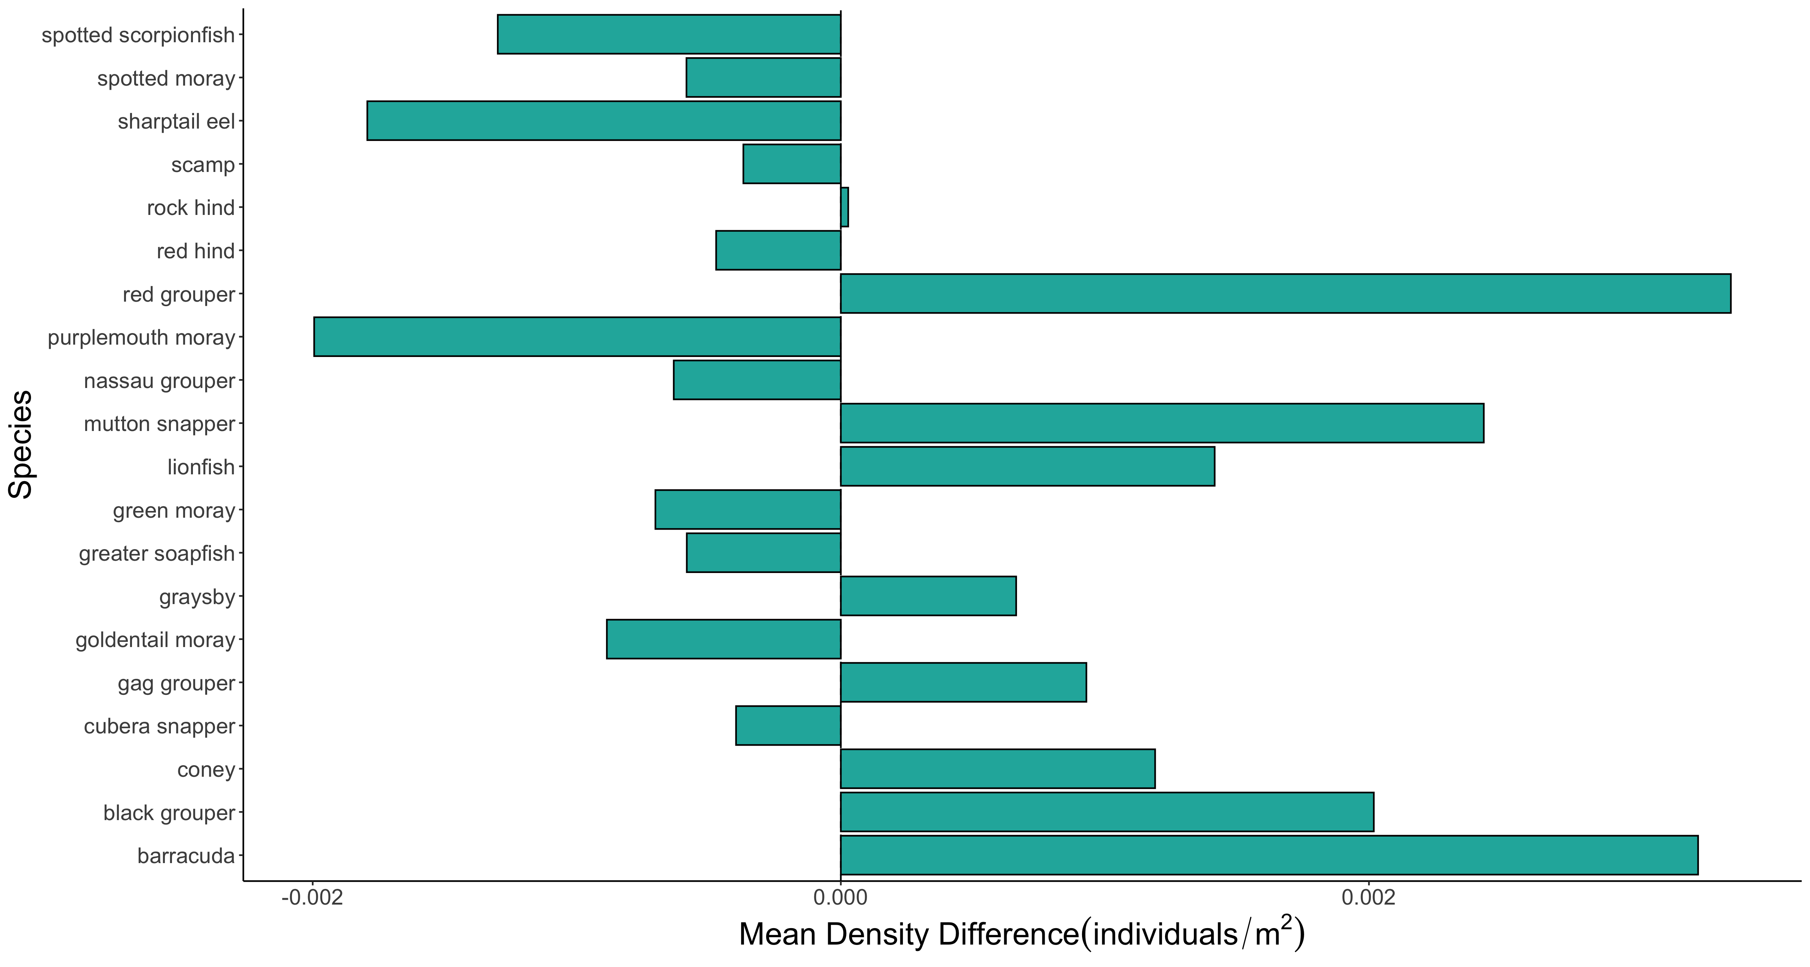

Slide 4
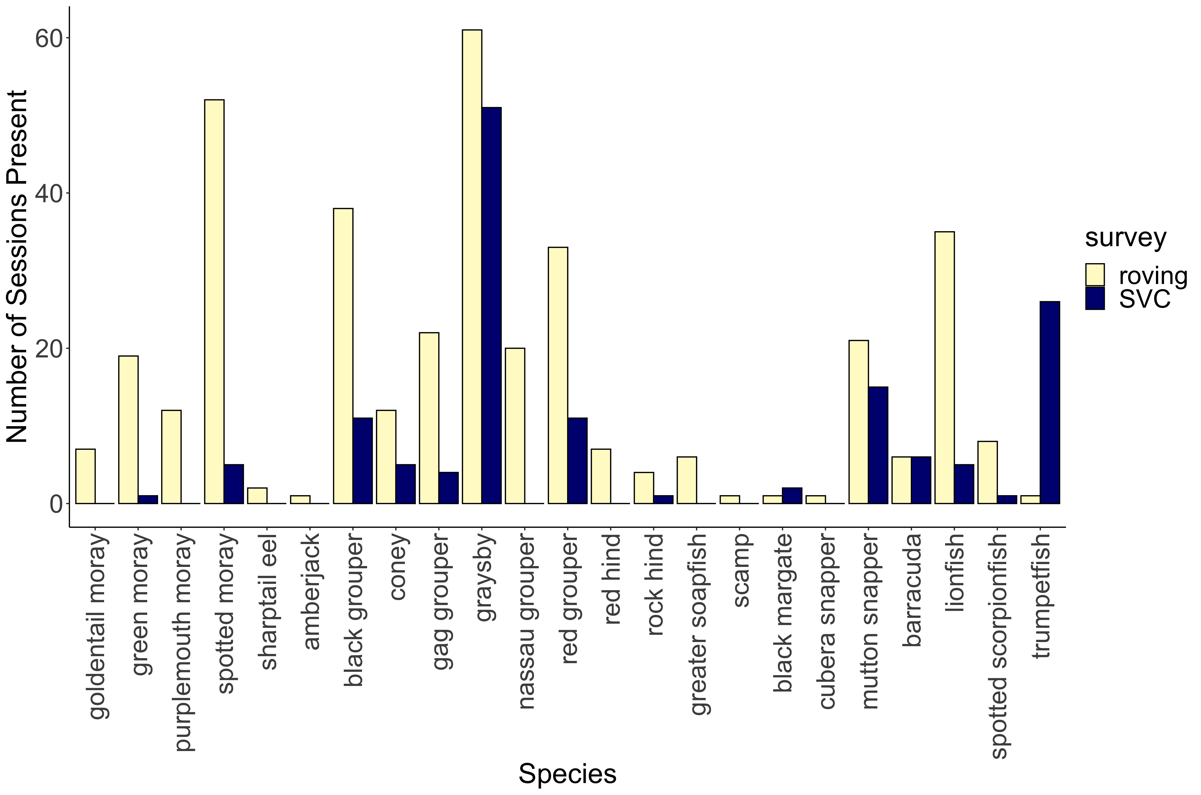
***
***
***
***
***
***
***
***
**
*
*
*
*

Slide 5
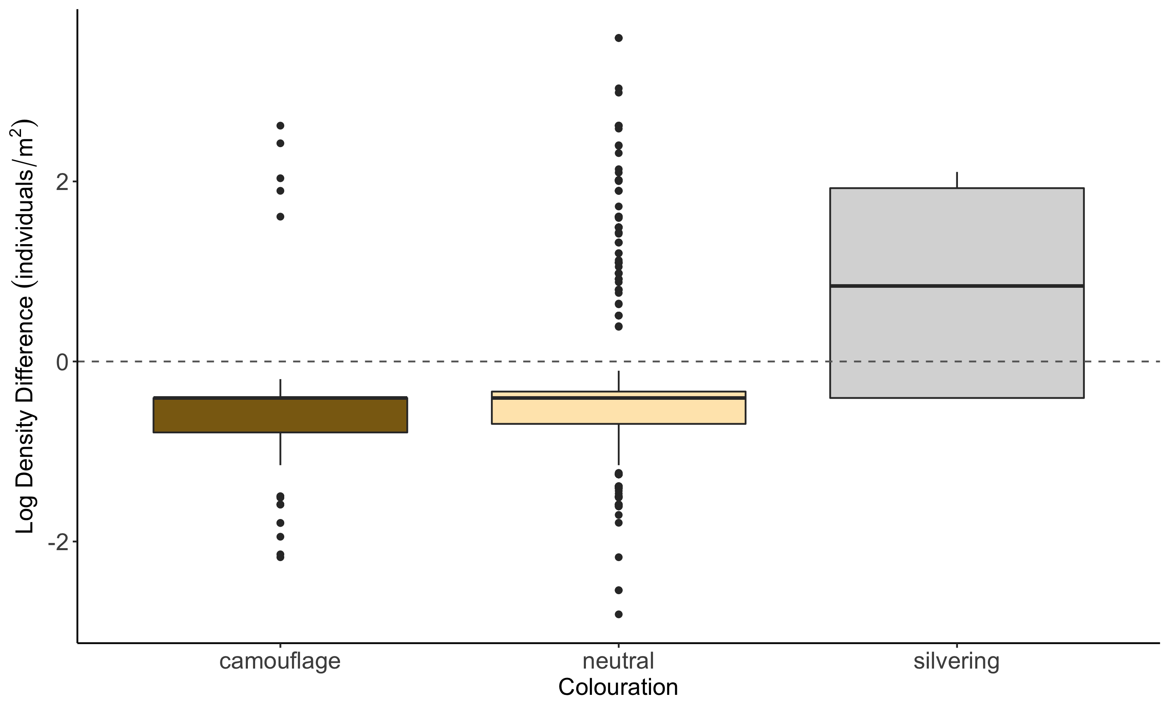
b
a
c

Slide 6
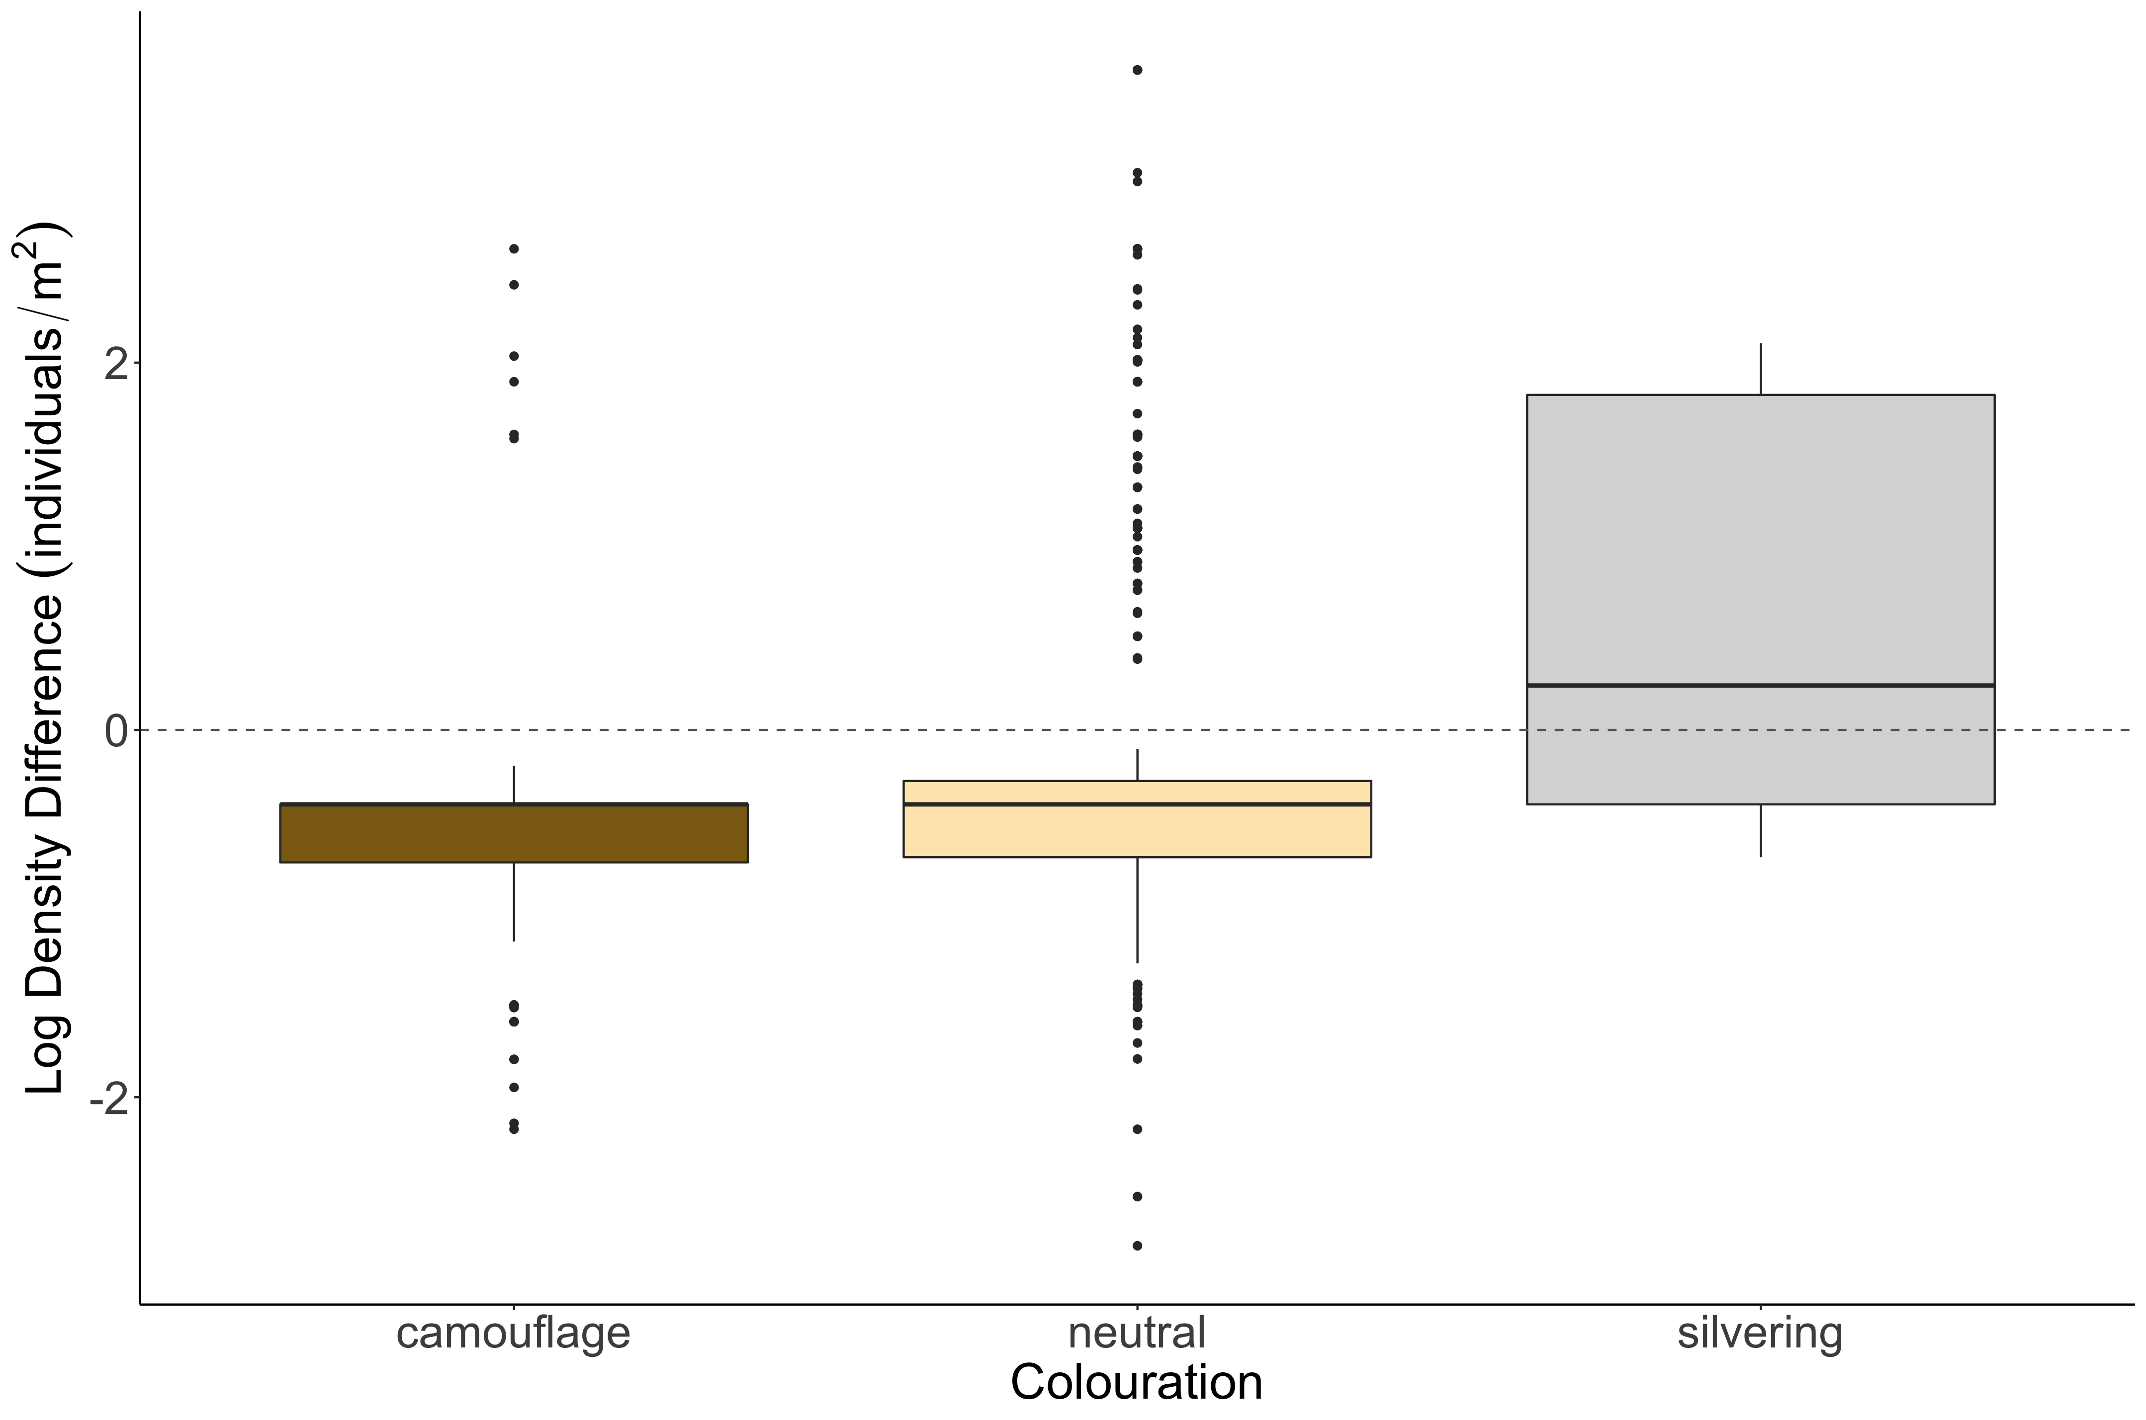
b
a
c

Slide 7
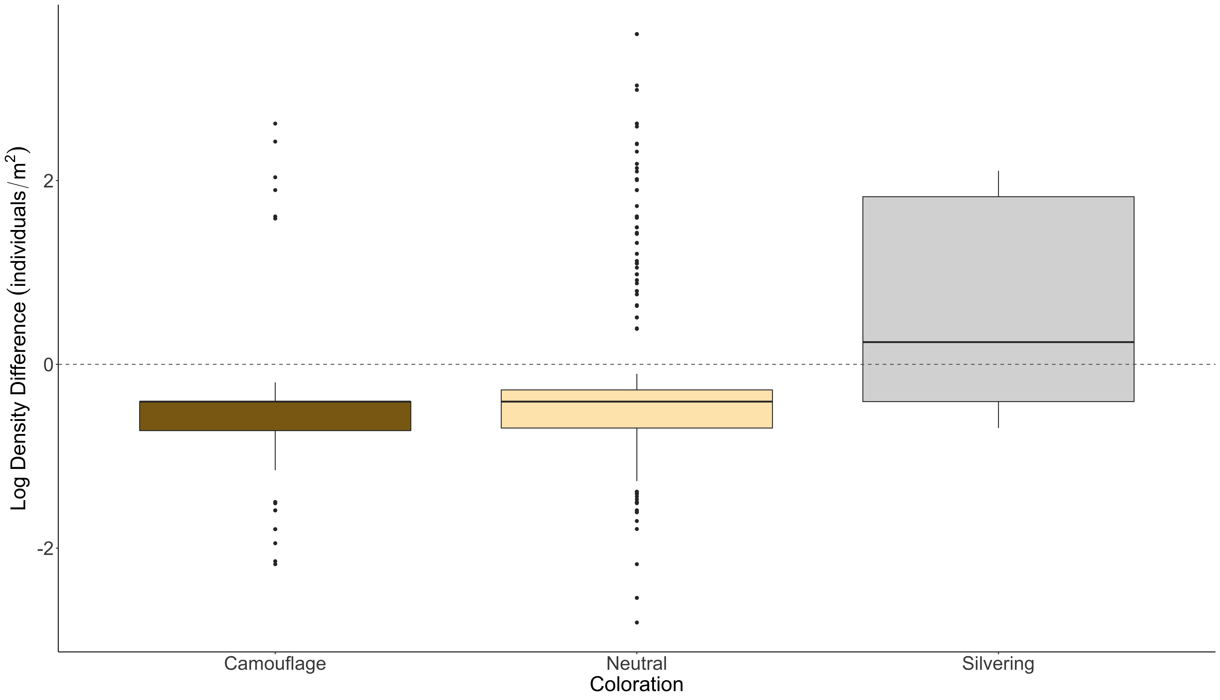
b
a
c

Slide 8
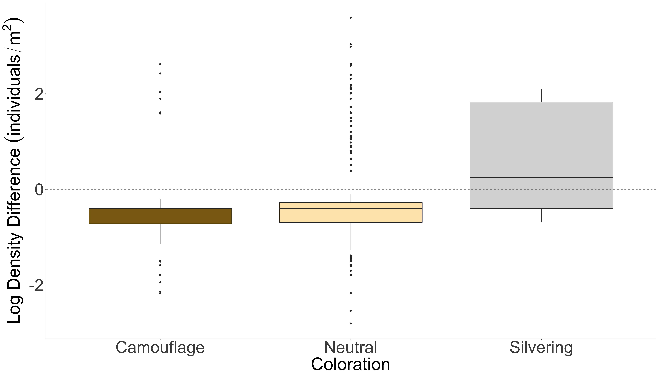
b
a
c

Slide 9
b
a
c
SVC
Density Greater
Roving Density Greater

Slide 10
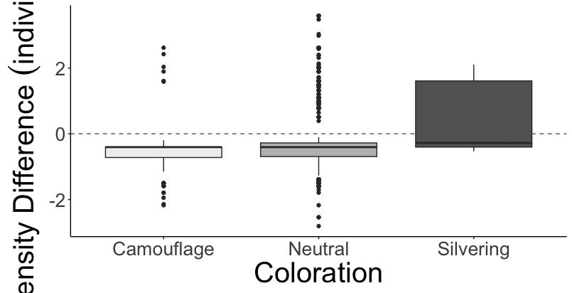
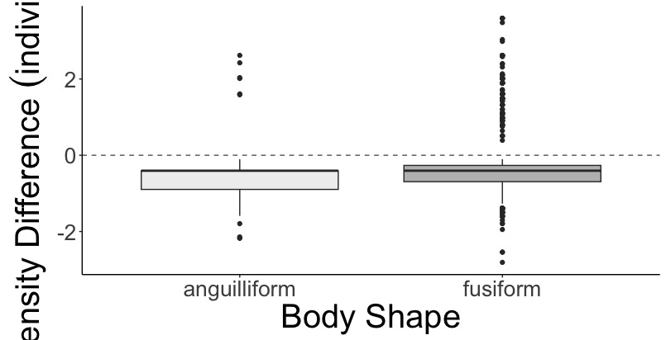
A.
a
b
c
SVC Density Greater
Belt Density Greater
Log Density Difference (individuals/m²)
B.
a
b
SVC Density Greater
Belt Density Greater

Slide 11
SVC vs. Transect Figures

Slide 12
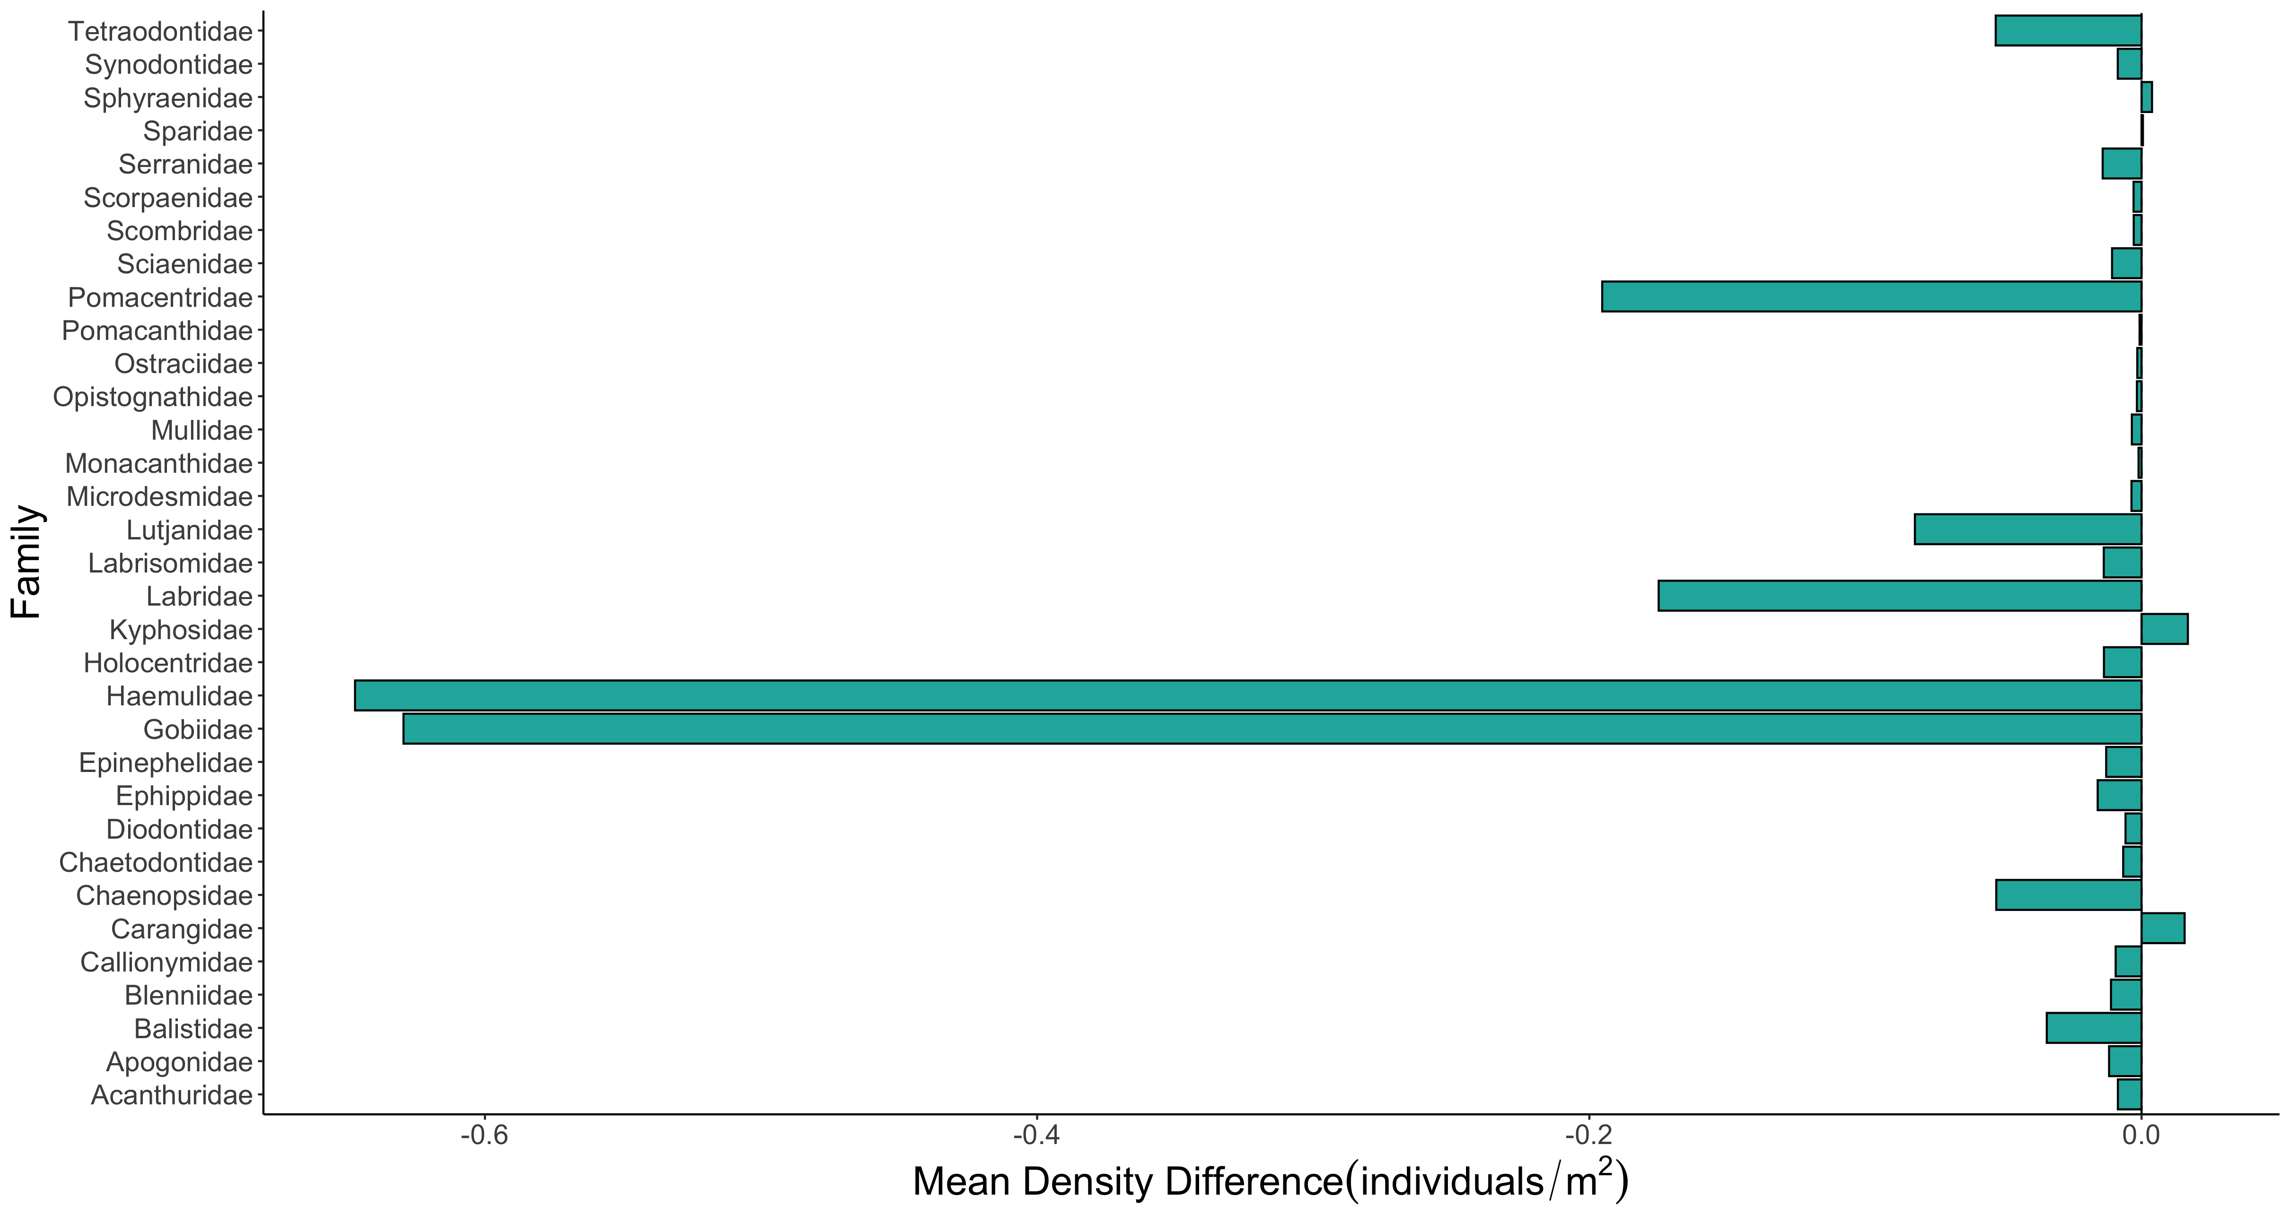

Slide 13
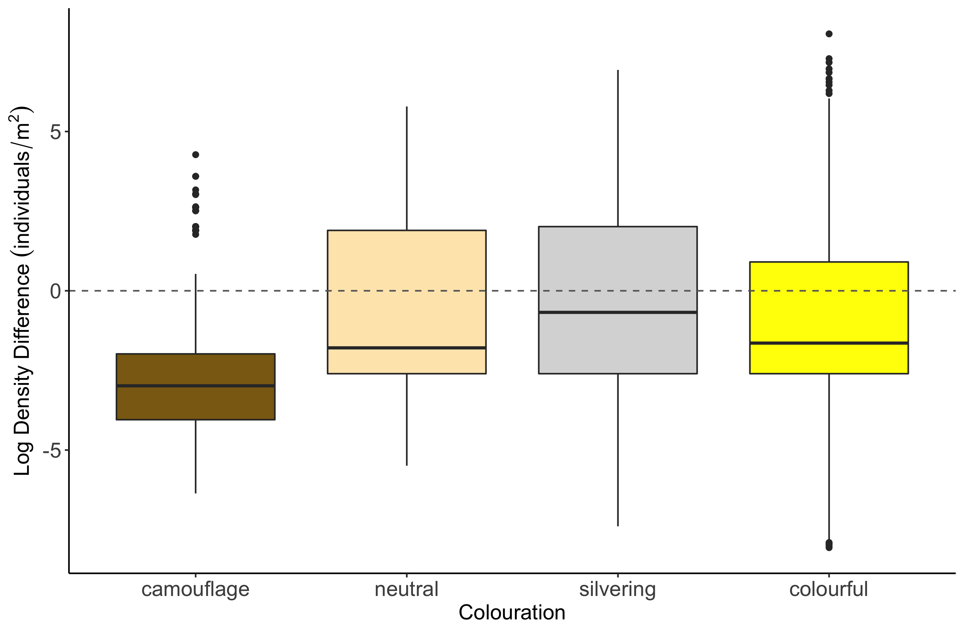
c
b
b
a

Slide 14
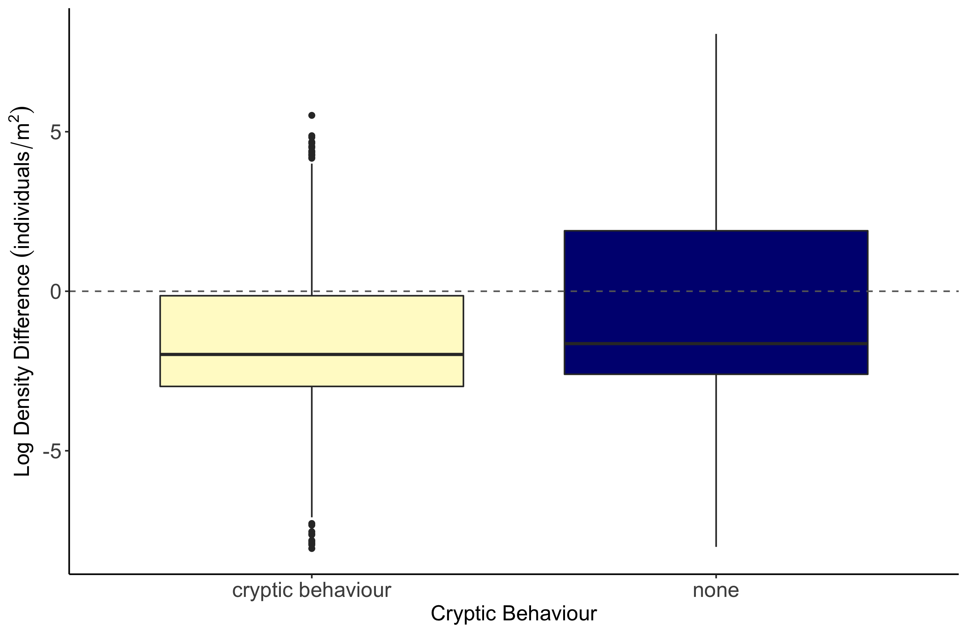
b
a

Slide 15
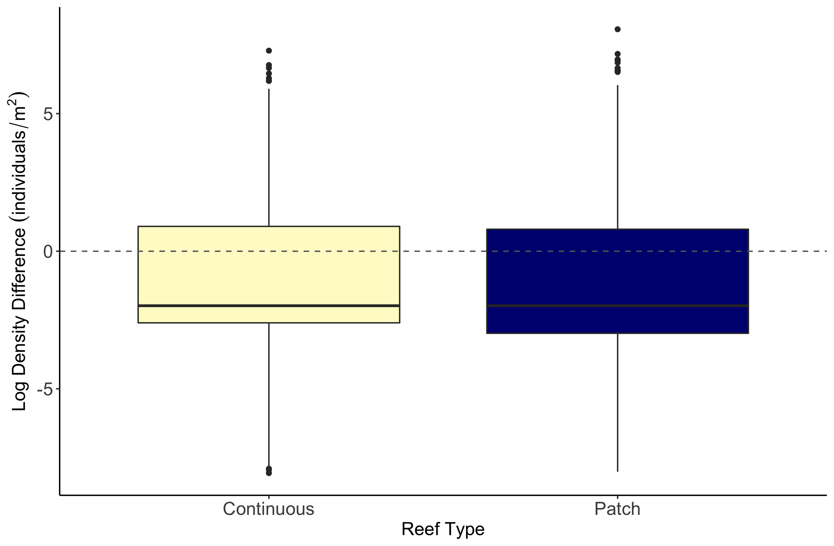
b
a

Slide 16
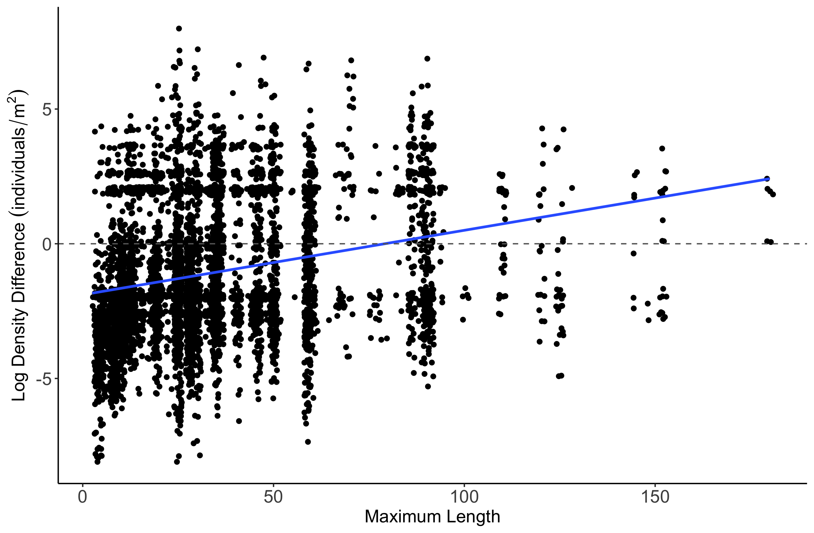
Estimate = 0.0077157
z value = 4.307
p-value = 1.65e-05

Slide 17
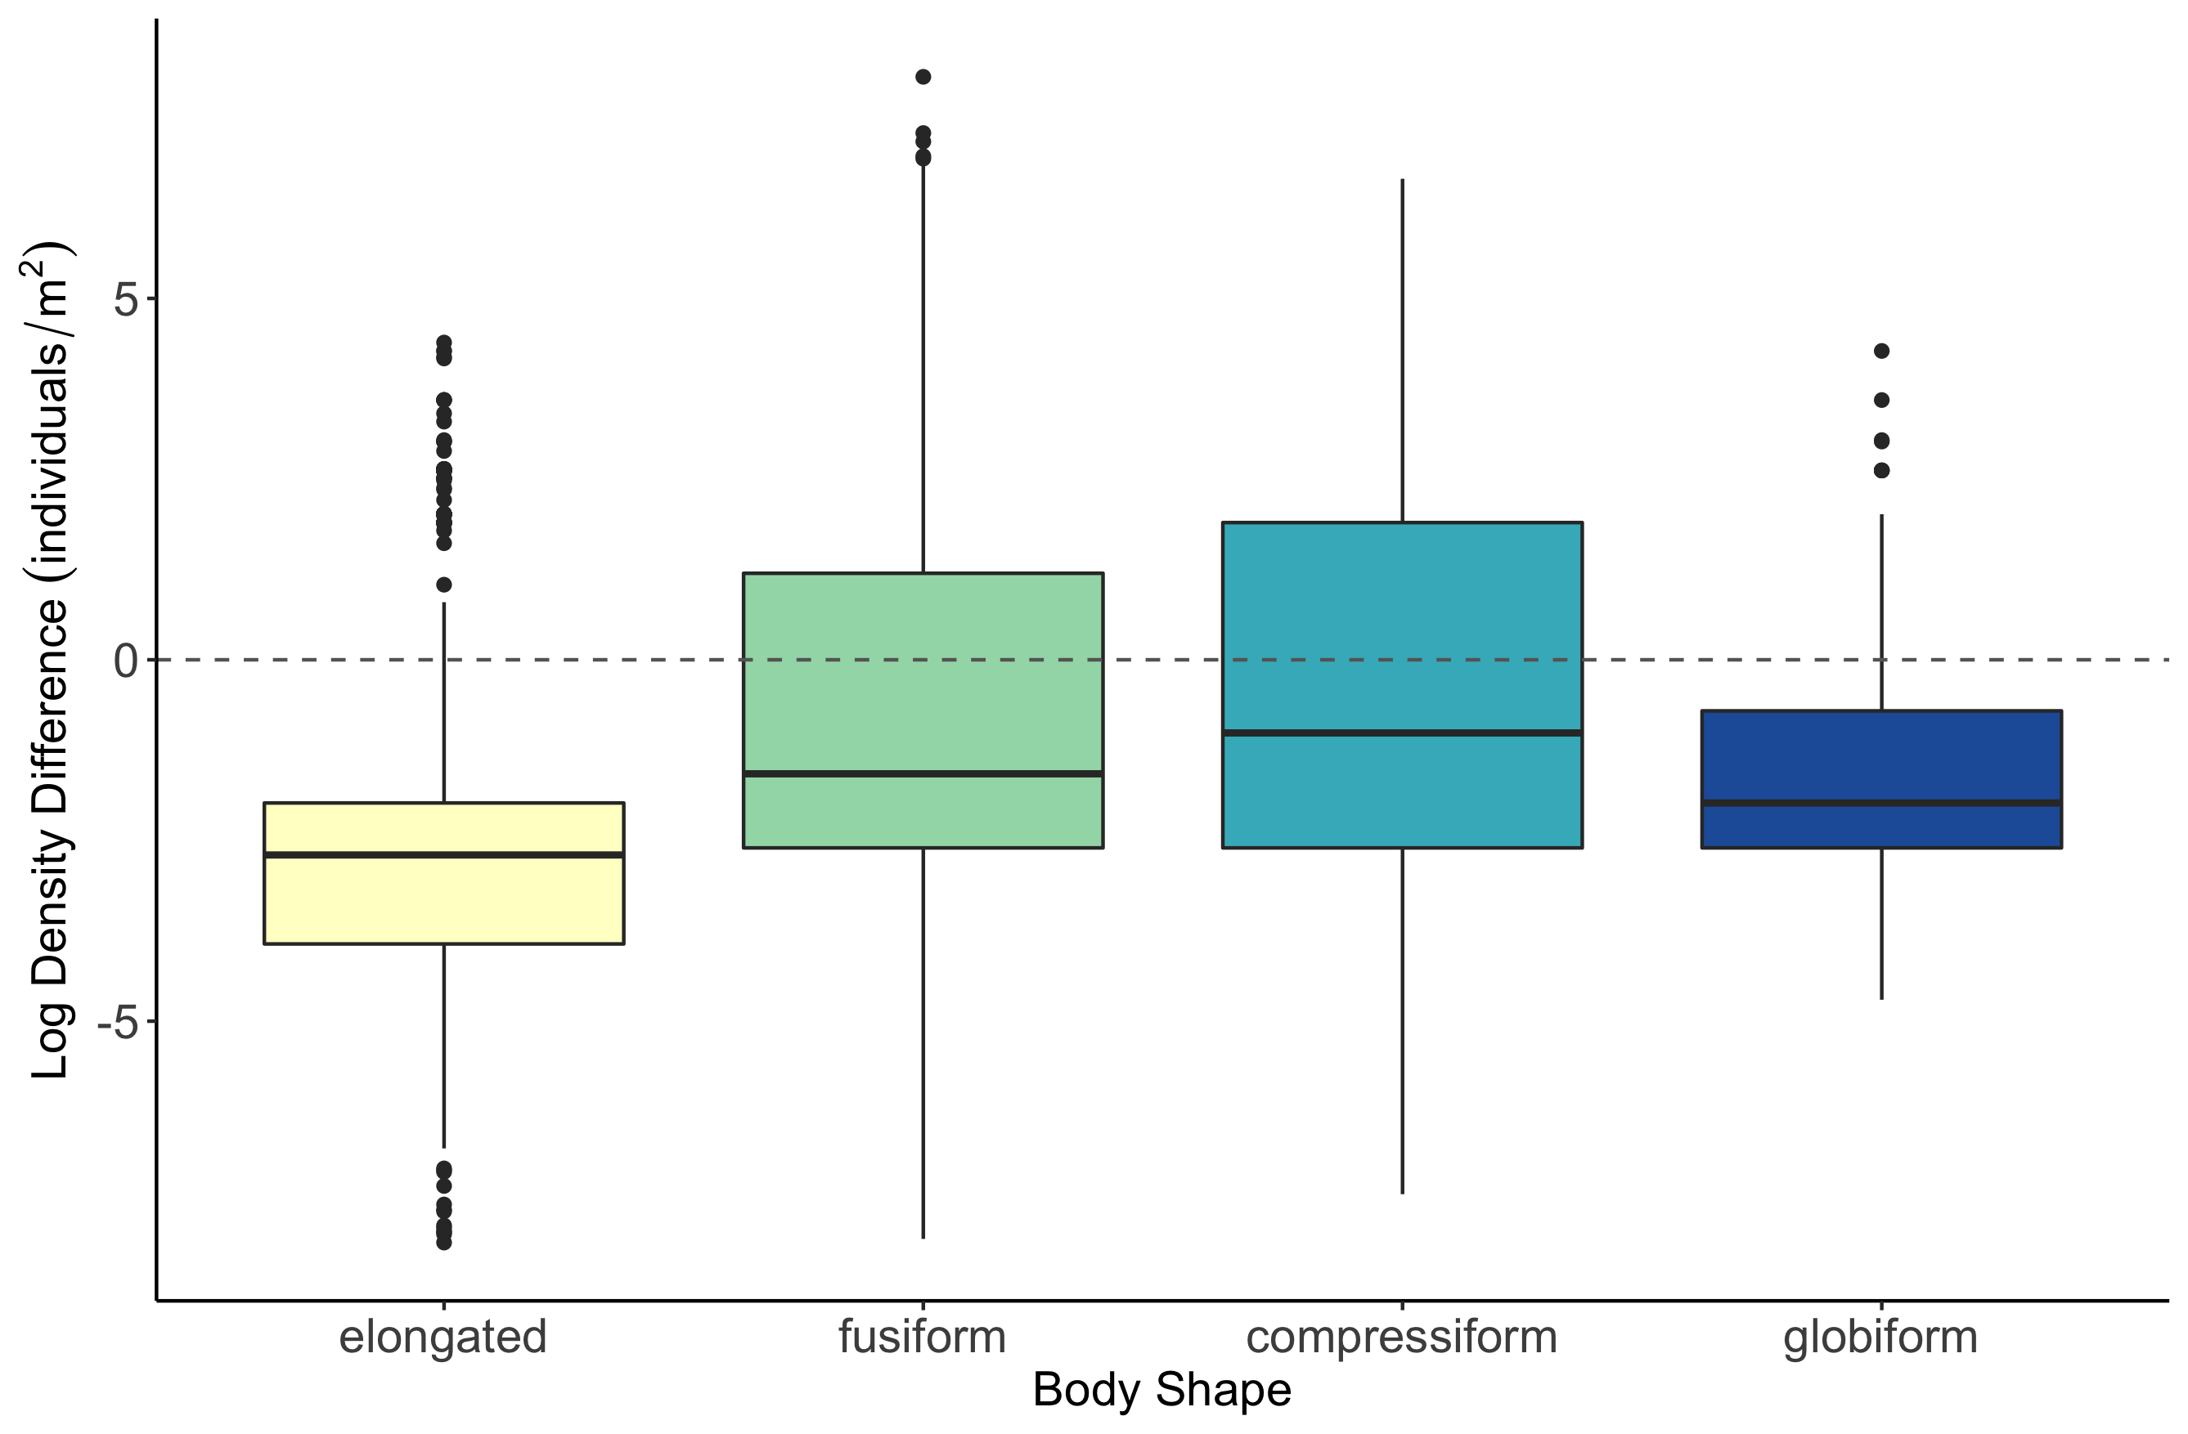
b
c
a
d

Slide 18
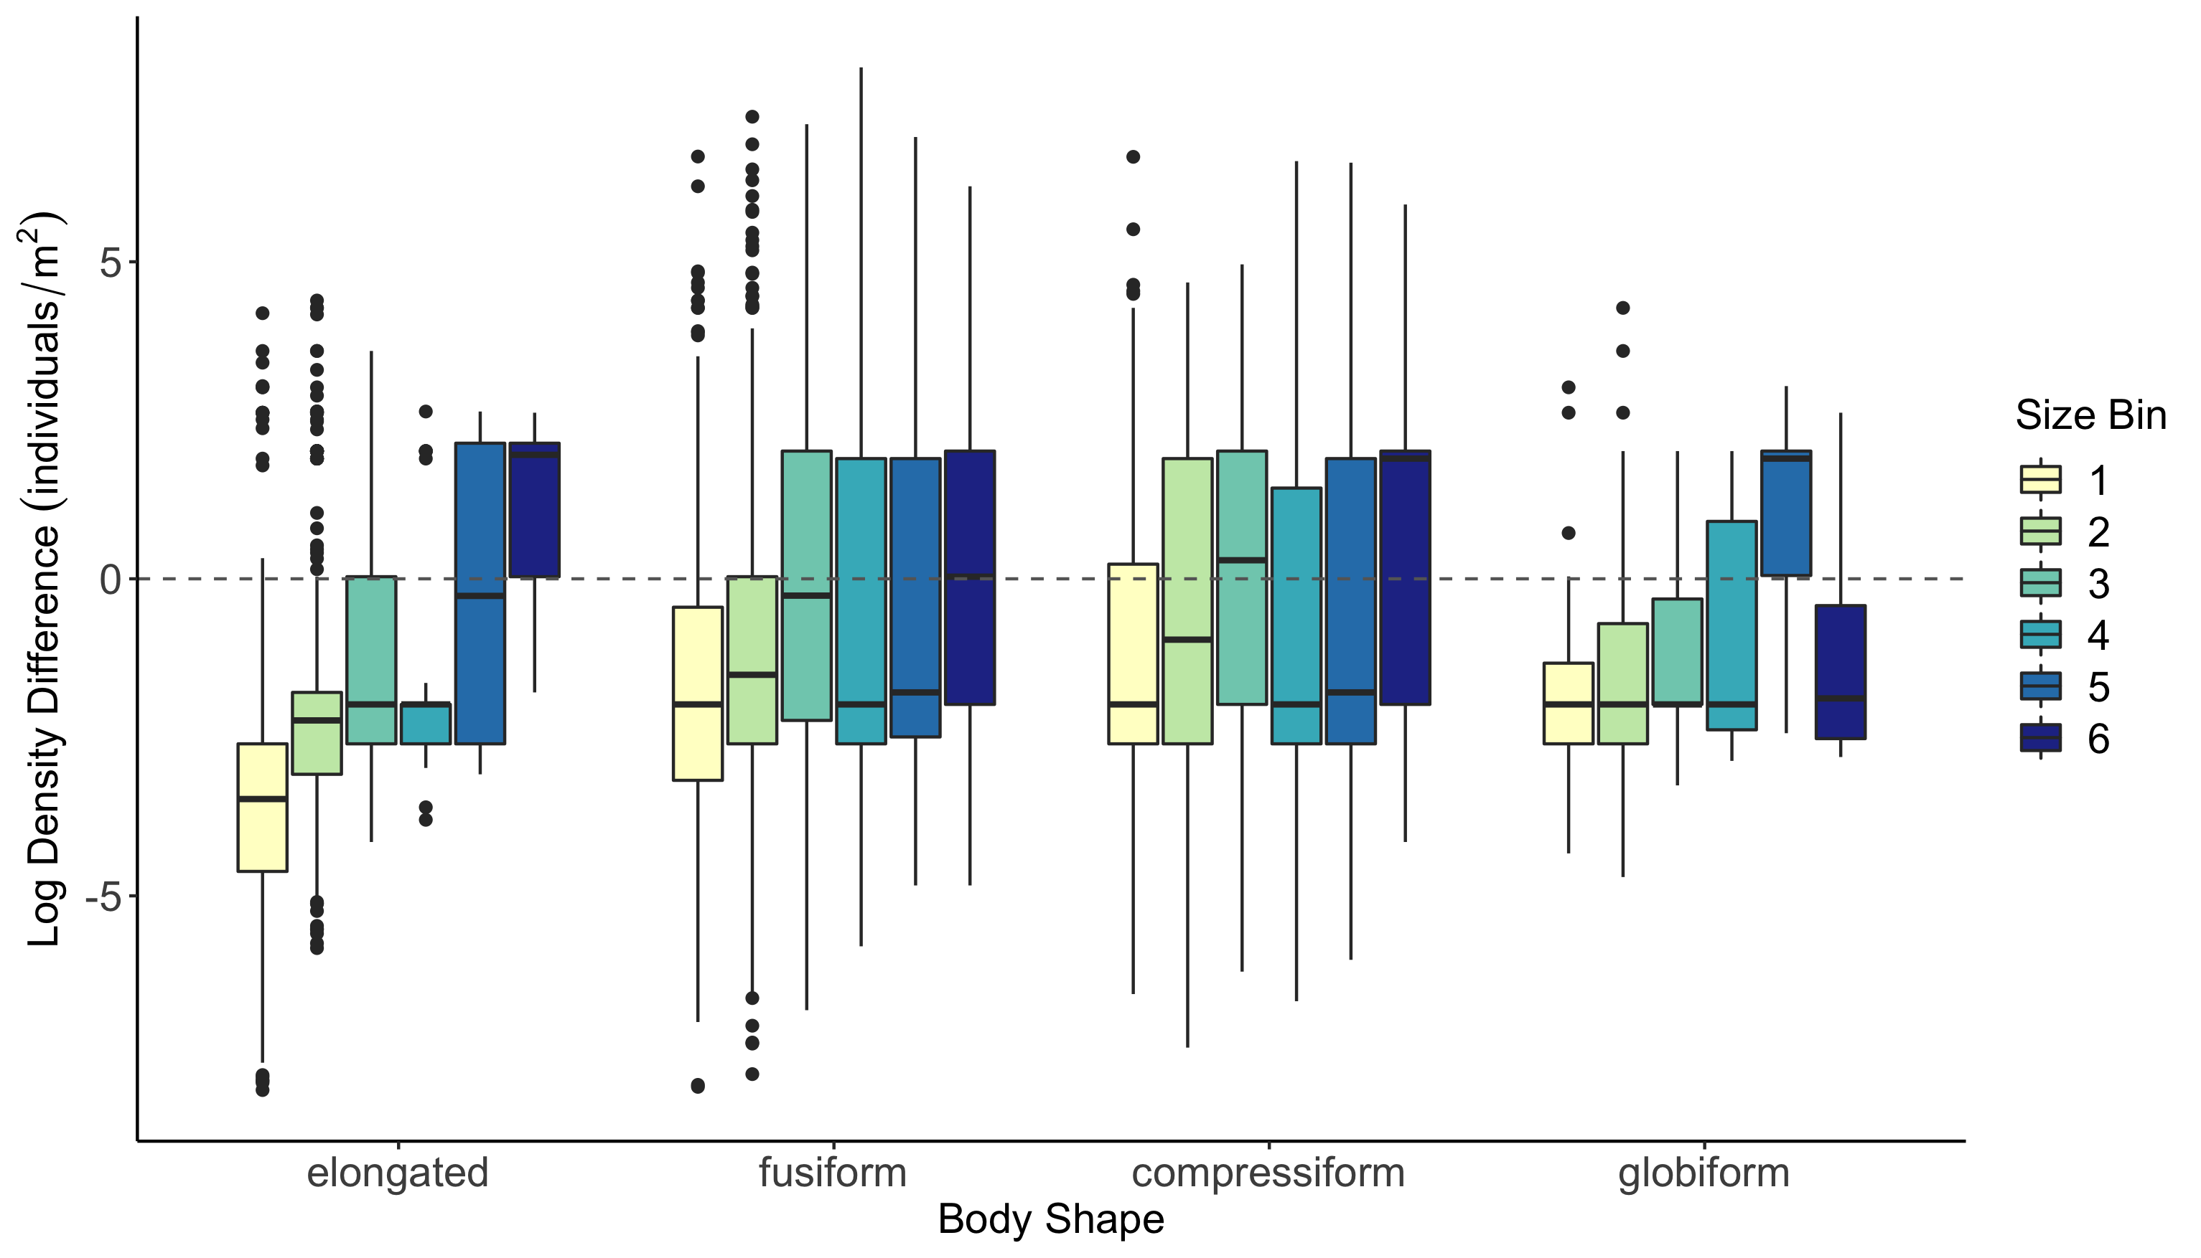

Slide 19
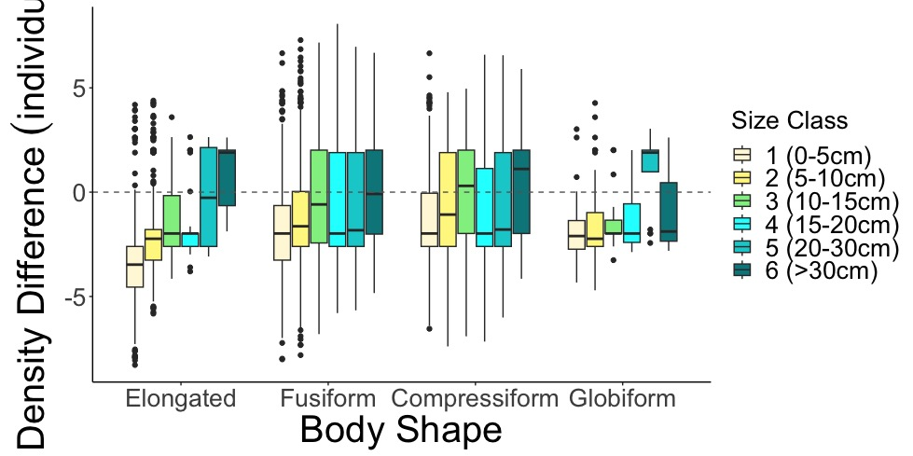
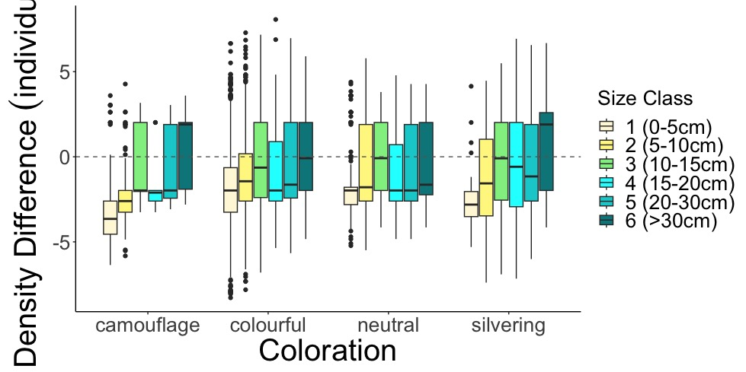
A.
SVC Density Greater
Belt Density Greater
Log Density Difference (individuals/m²)
B.
SVC Density Greater
Belt Density Greater

Slide 20
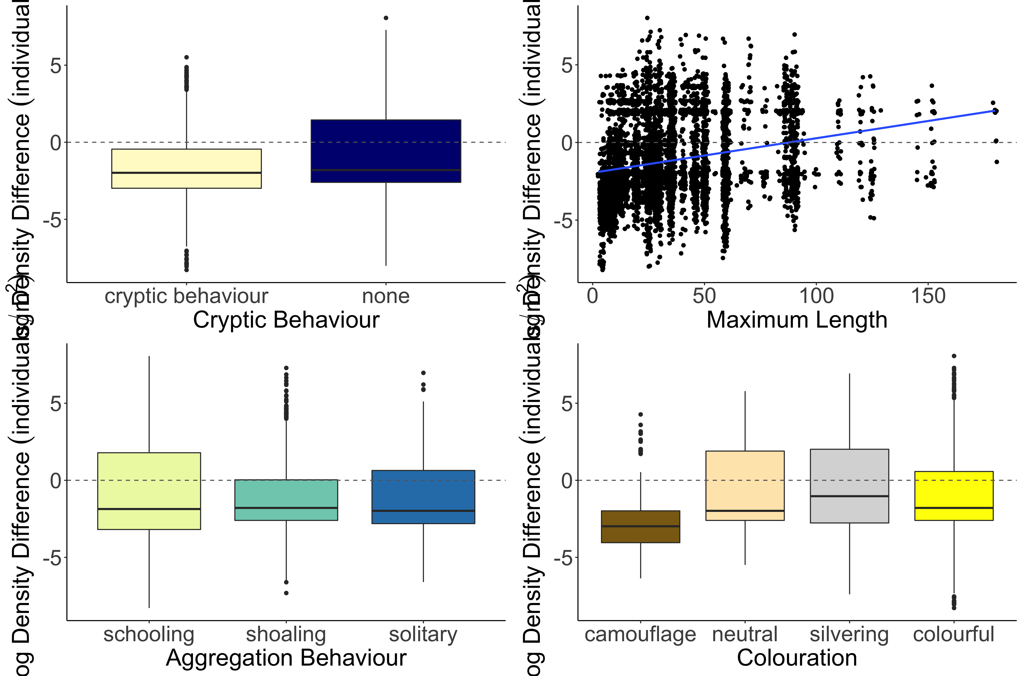
b
Estimate = 0.006355
z value = 3.801
p-value = 0.000144
a
Log Density Difference (individuals/m²)
c
b
b
a

Slide 21
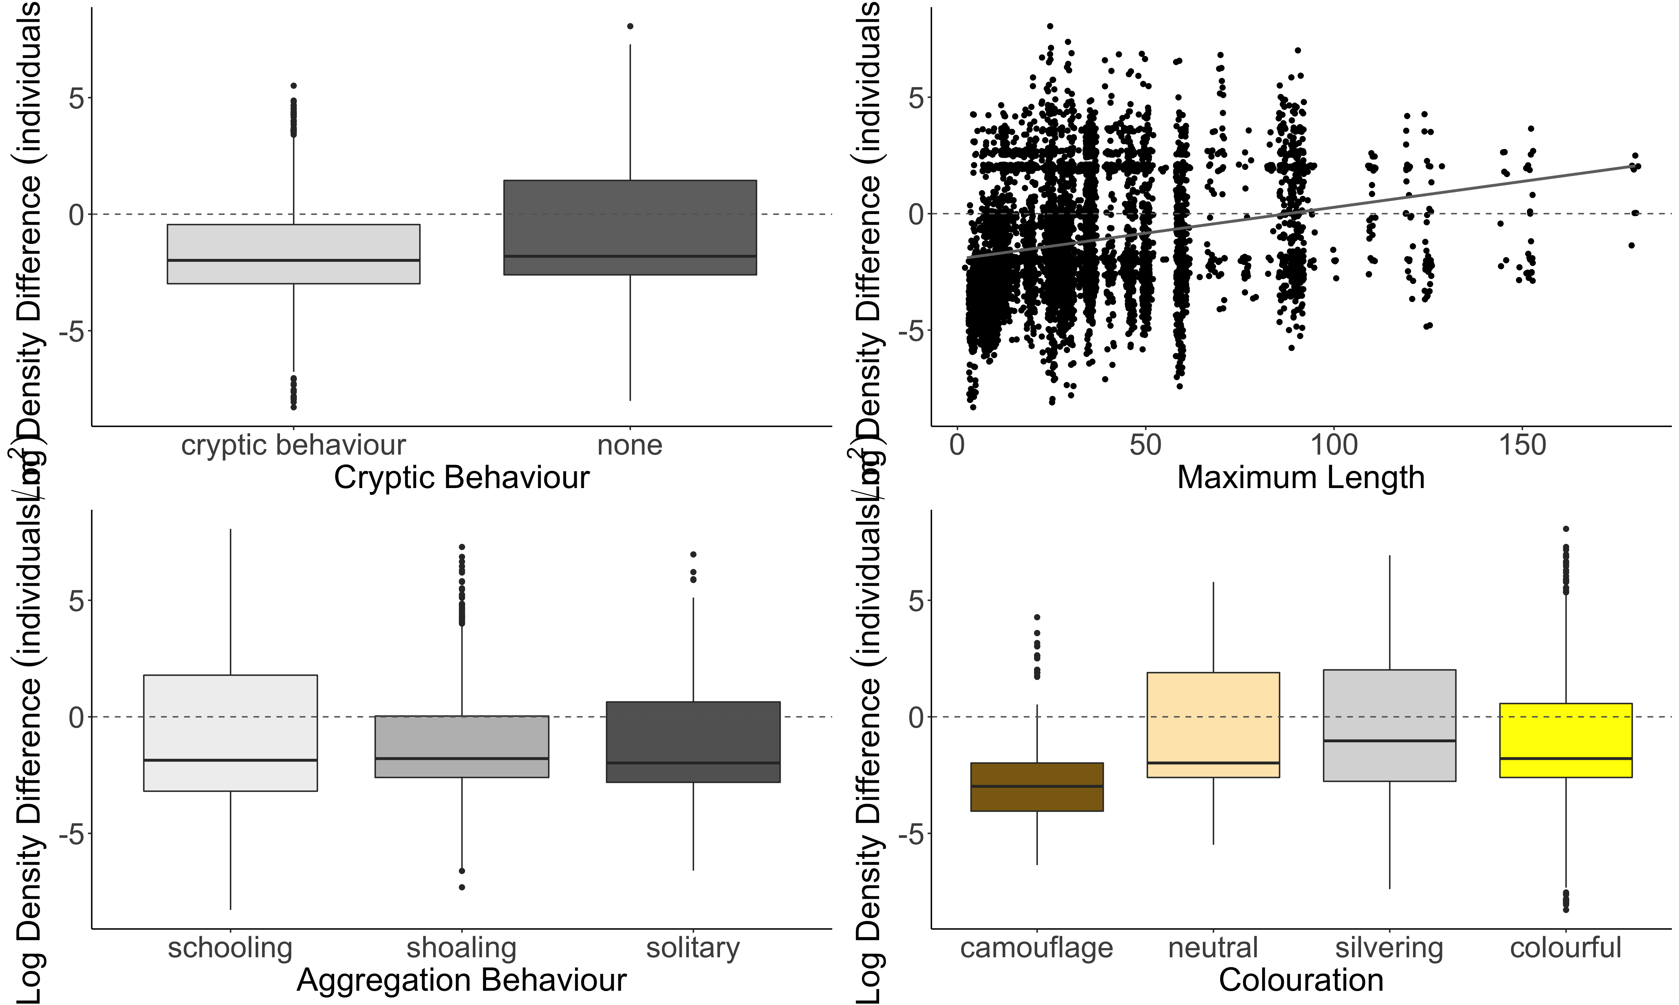
A.
b
B.
Estimate = 0.006355
z value = 3.801
p-value = 0.000144
a
C.
D.
Log Density Difference (individuals/m²)
a
a
b
b
b
b
a

Slide 22
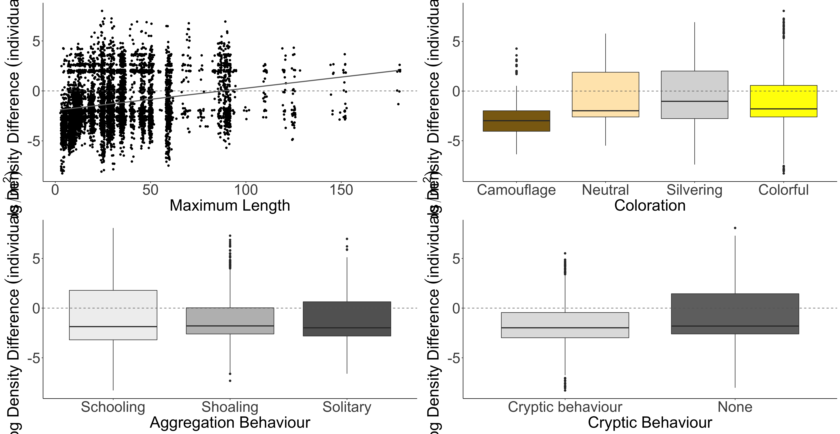
A.
B.
b
b
SVC
Density Greater
b
SVC
Density Greater
a
Belt Transect Density Greater
Belt Transect Density Greater
Log Density Difference (individuals/m²)
C.
a
D.
a
b
b
SVC
Density Greater
a
SVC
Density Greater
Belt Transect Density Greater
Belt Transect Density Greater

Slide 23
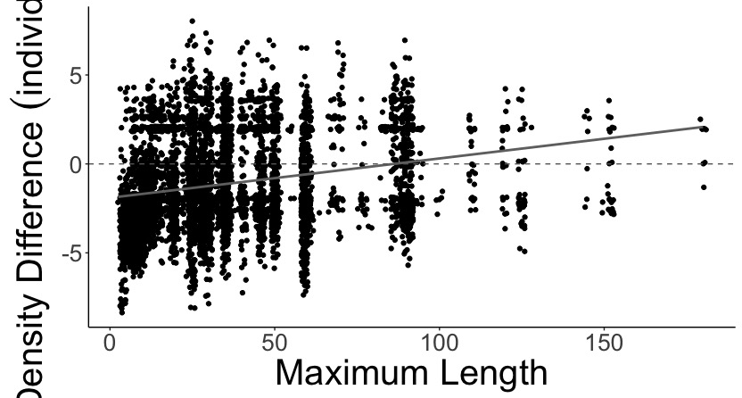
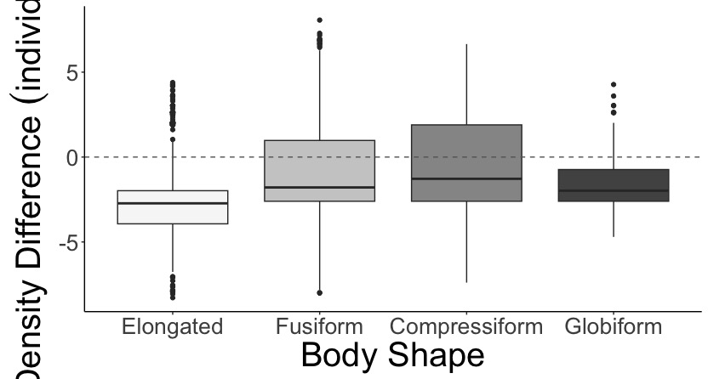
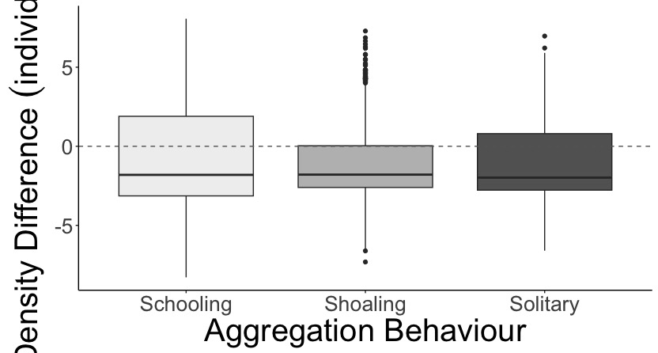
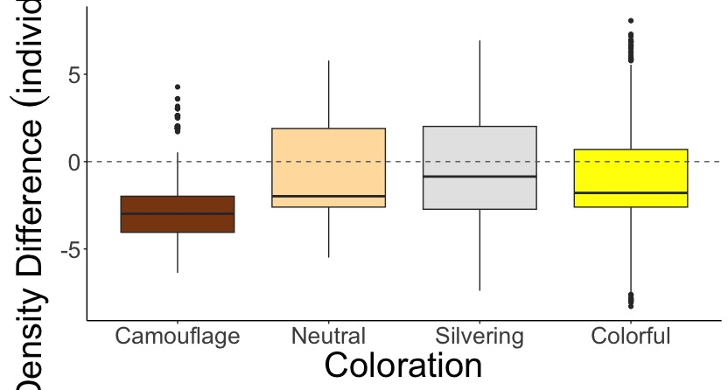
A.
B.
estimate = 0.008
z-value = 4.07
p < 0.01
a
b
c
d
SVC Density Greater
SVC Density Greater
Belt Density Greater
Belt Density Greater
Log Density Difference (individuals/m²)
C.
a
a
a
D.
a
b
b
c
SVC Density Greater
SVC Density Greater
Belt Density Greater
Belt Density Greater

Slide 24
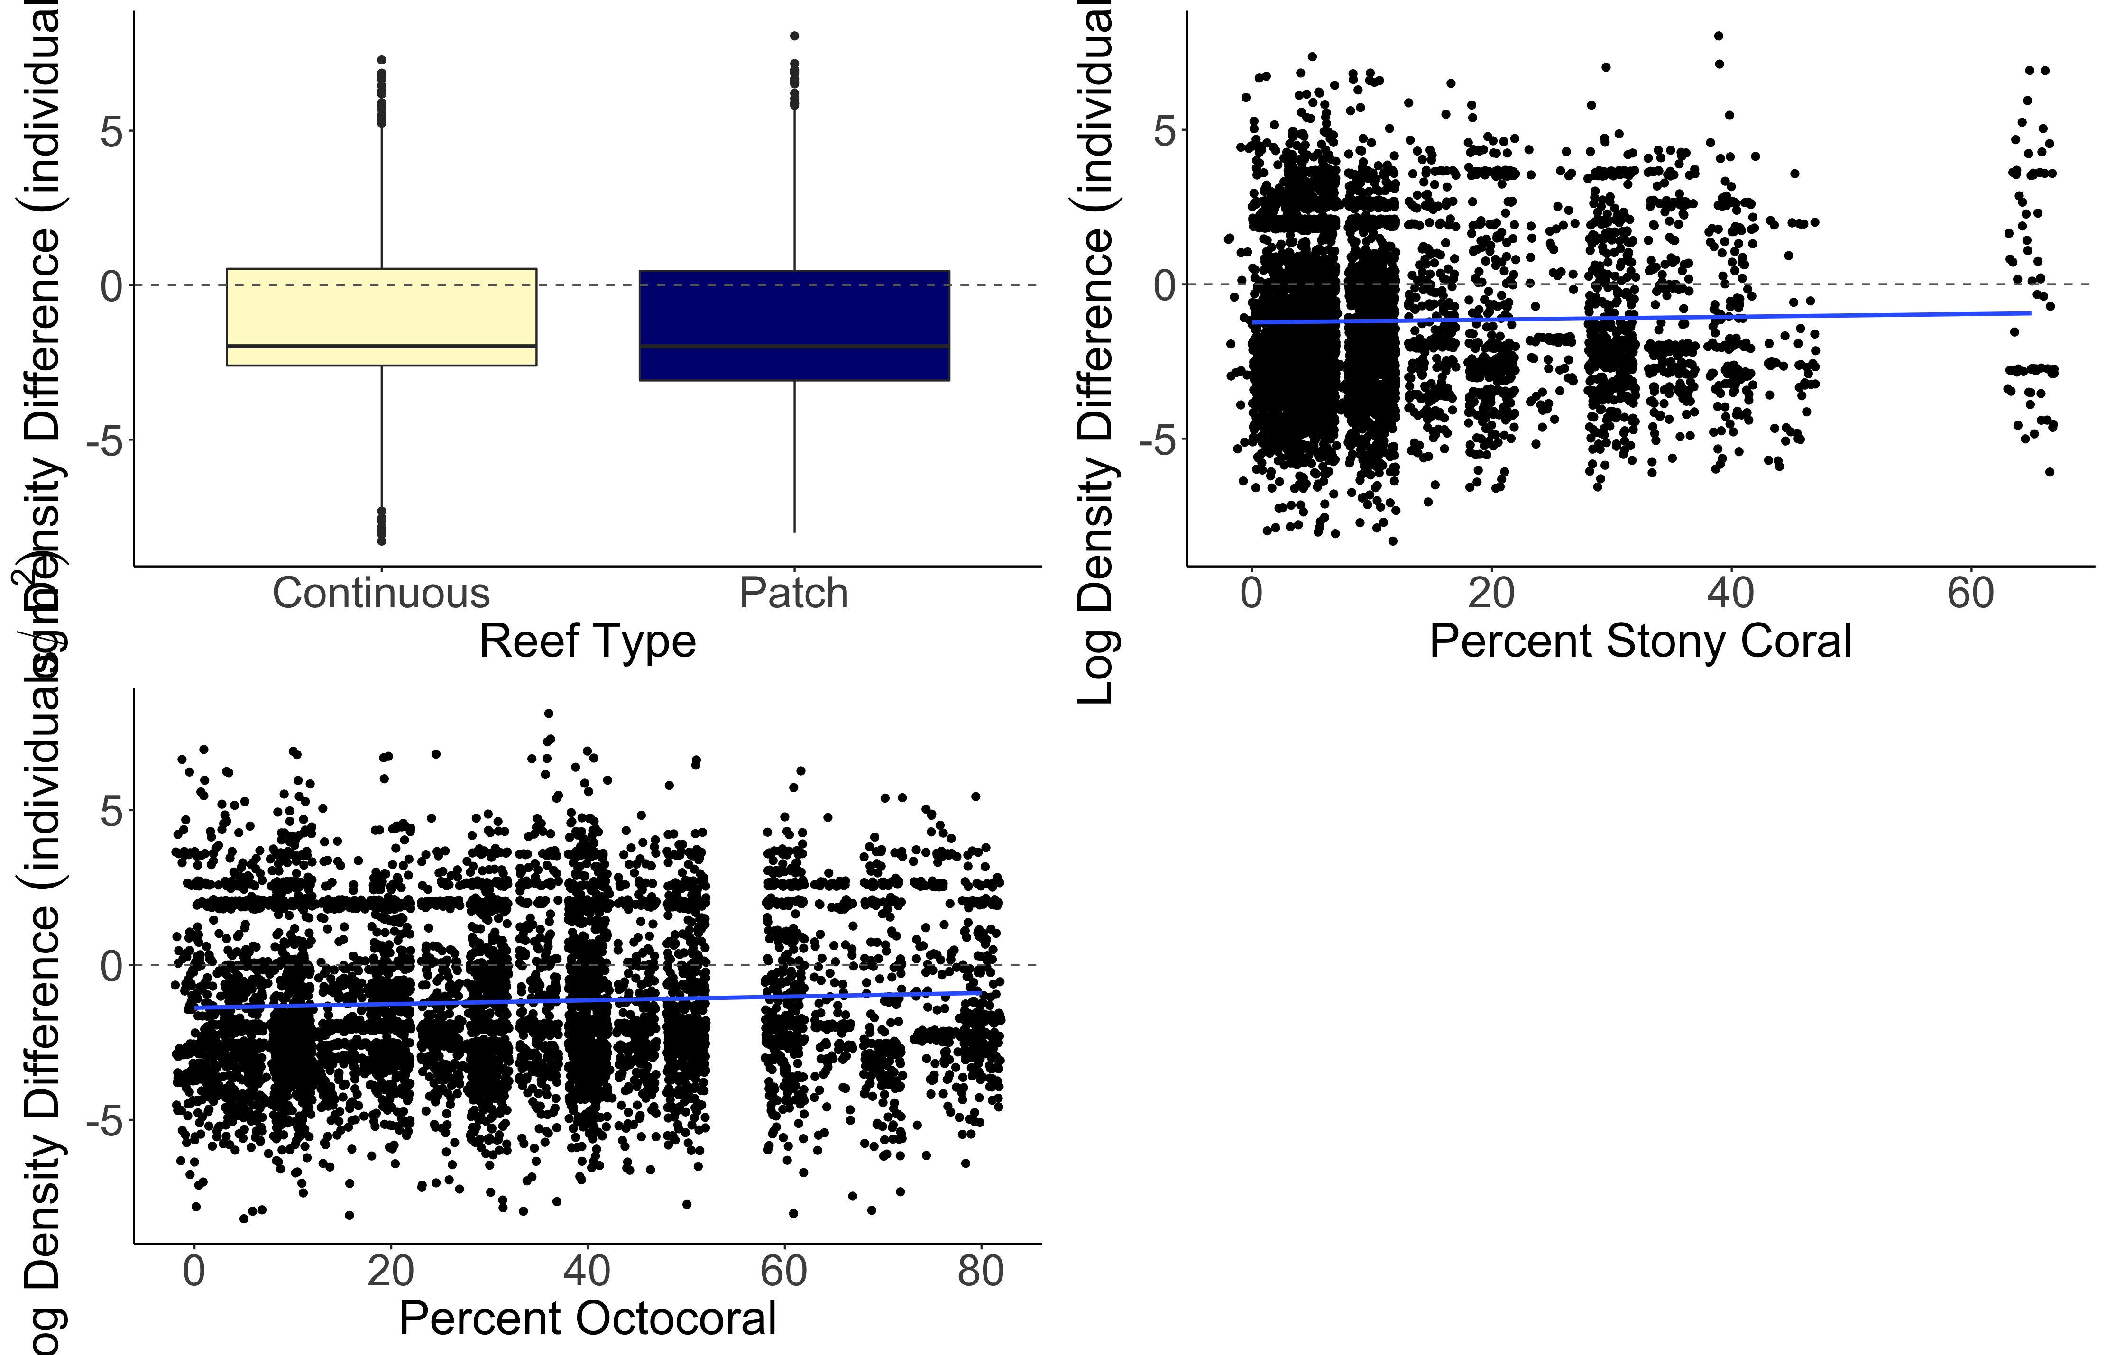
a
b
Estimate = 0.015630
z value = 4.570
p-value = 4.9e-06
Log Density Difference (individuals/m²)
Estimate = 0.009786
z value = 6.254
p-value = < 2e-16

Slide 25
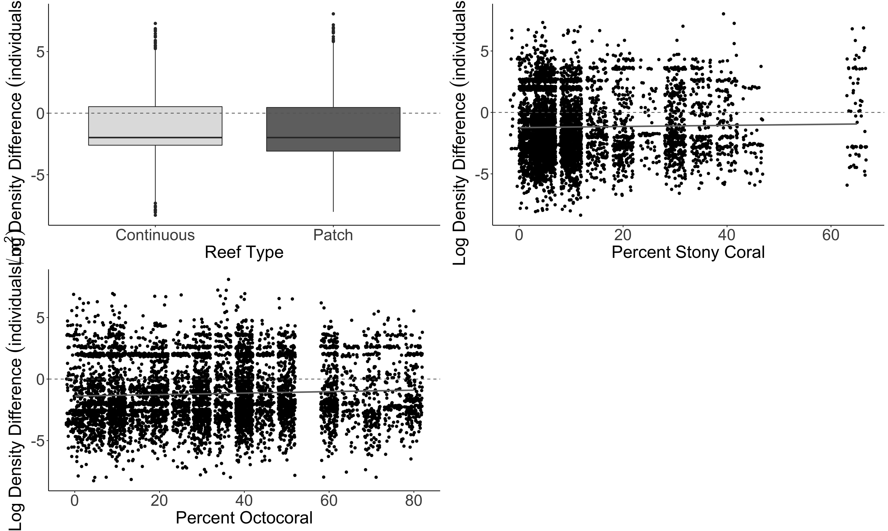
A.
B.
a
b
Estimate = 0.015630
z value = 4.570
p-value = 4.9e-06
Log Density Difference (individuals/m²)
C.
Estimate = 0.009786
z value = 6.254
p-value = < 2e-16

Slide 26
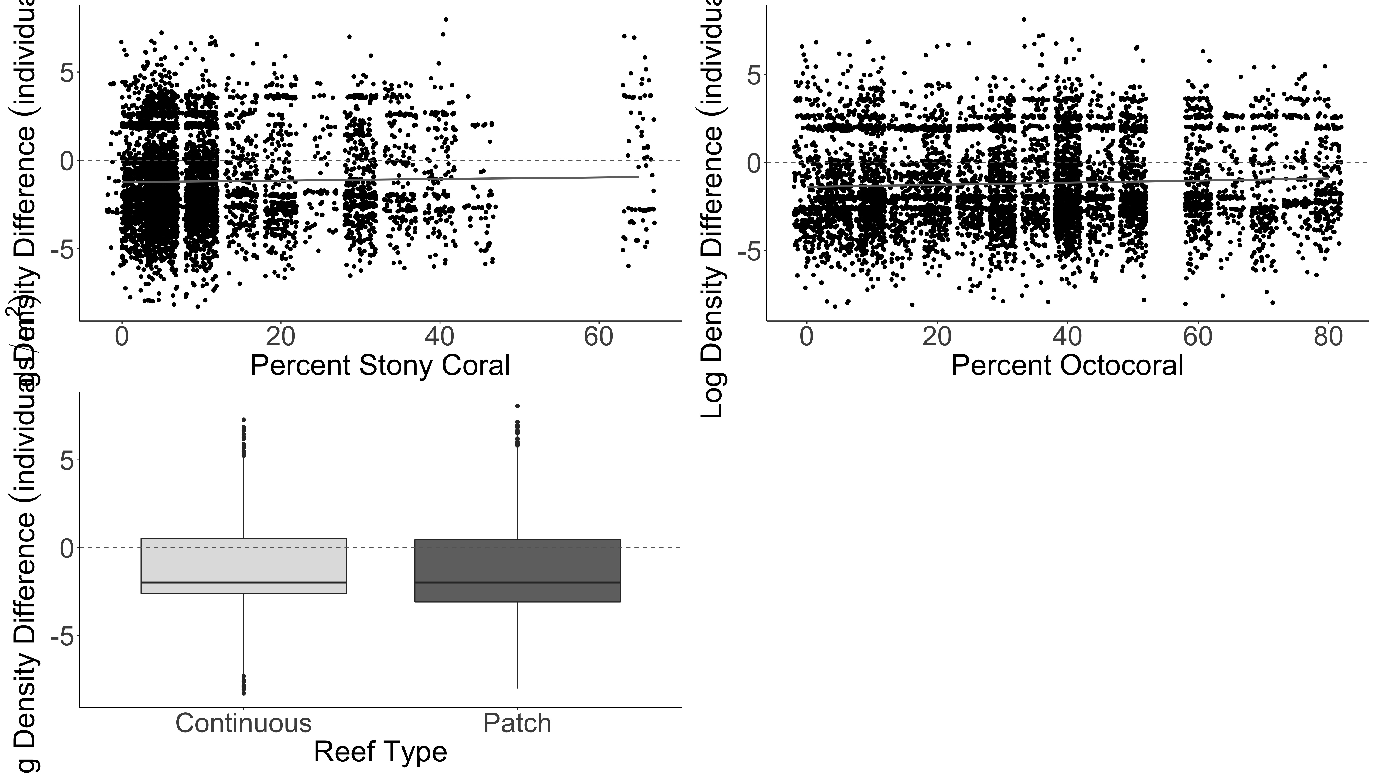
Estimate = 0.015630
z value = 4.570
p-value = 4.9e-06
Estimate = 0.009786
z value = 6.254
p-value = < 2e-16
A.
B.
Log Density Difference (individuals/m²)
C.
a
b

Slide 27
A.
B.
SVC
Density Greater
SVC
Density Greater
Belt Transect Density Greater
Belt Transect Density Greater
Log Density Difference (individuals/m²)
C.
a
b
SVC
Density Greater
Belt Transect Density Greater

Slide 28
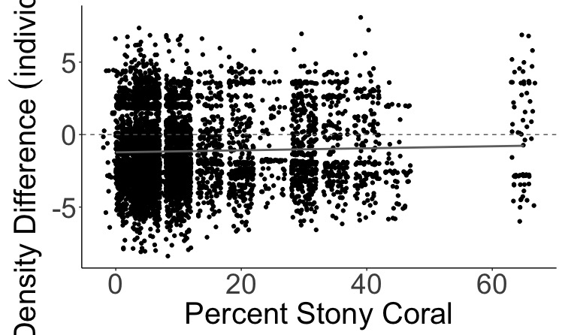
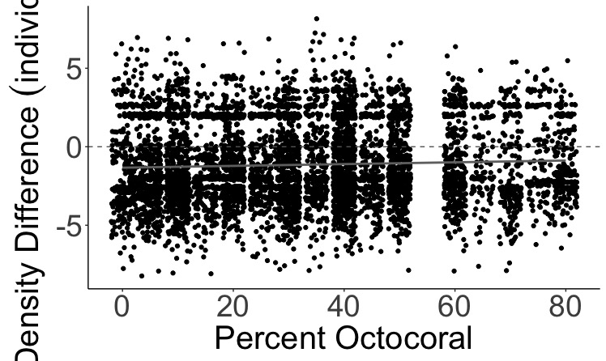
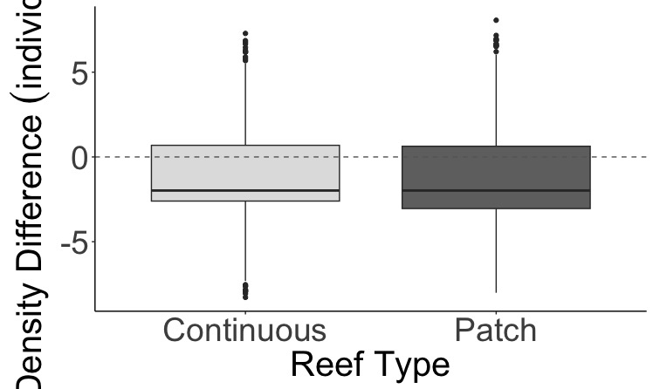
A.
SVC Density Greater
estimate = 0.017
z-value = 4.89
p < 0.01
Belt Density Greater
B.
SVC Density Greater
Log Density Difference (individuals/m²)
estimate = 0.009
z-value = 5.95
p < 0.01
Belt Density Greater
C.
a
b
SVC Density Greater
Belt Density Greater

Slide 29
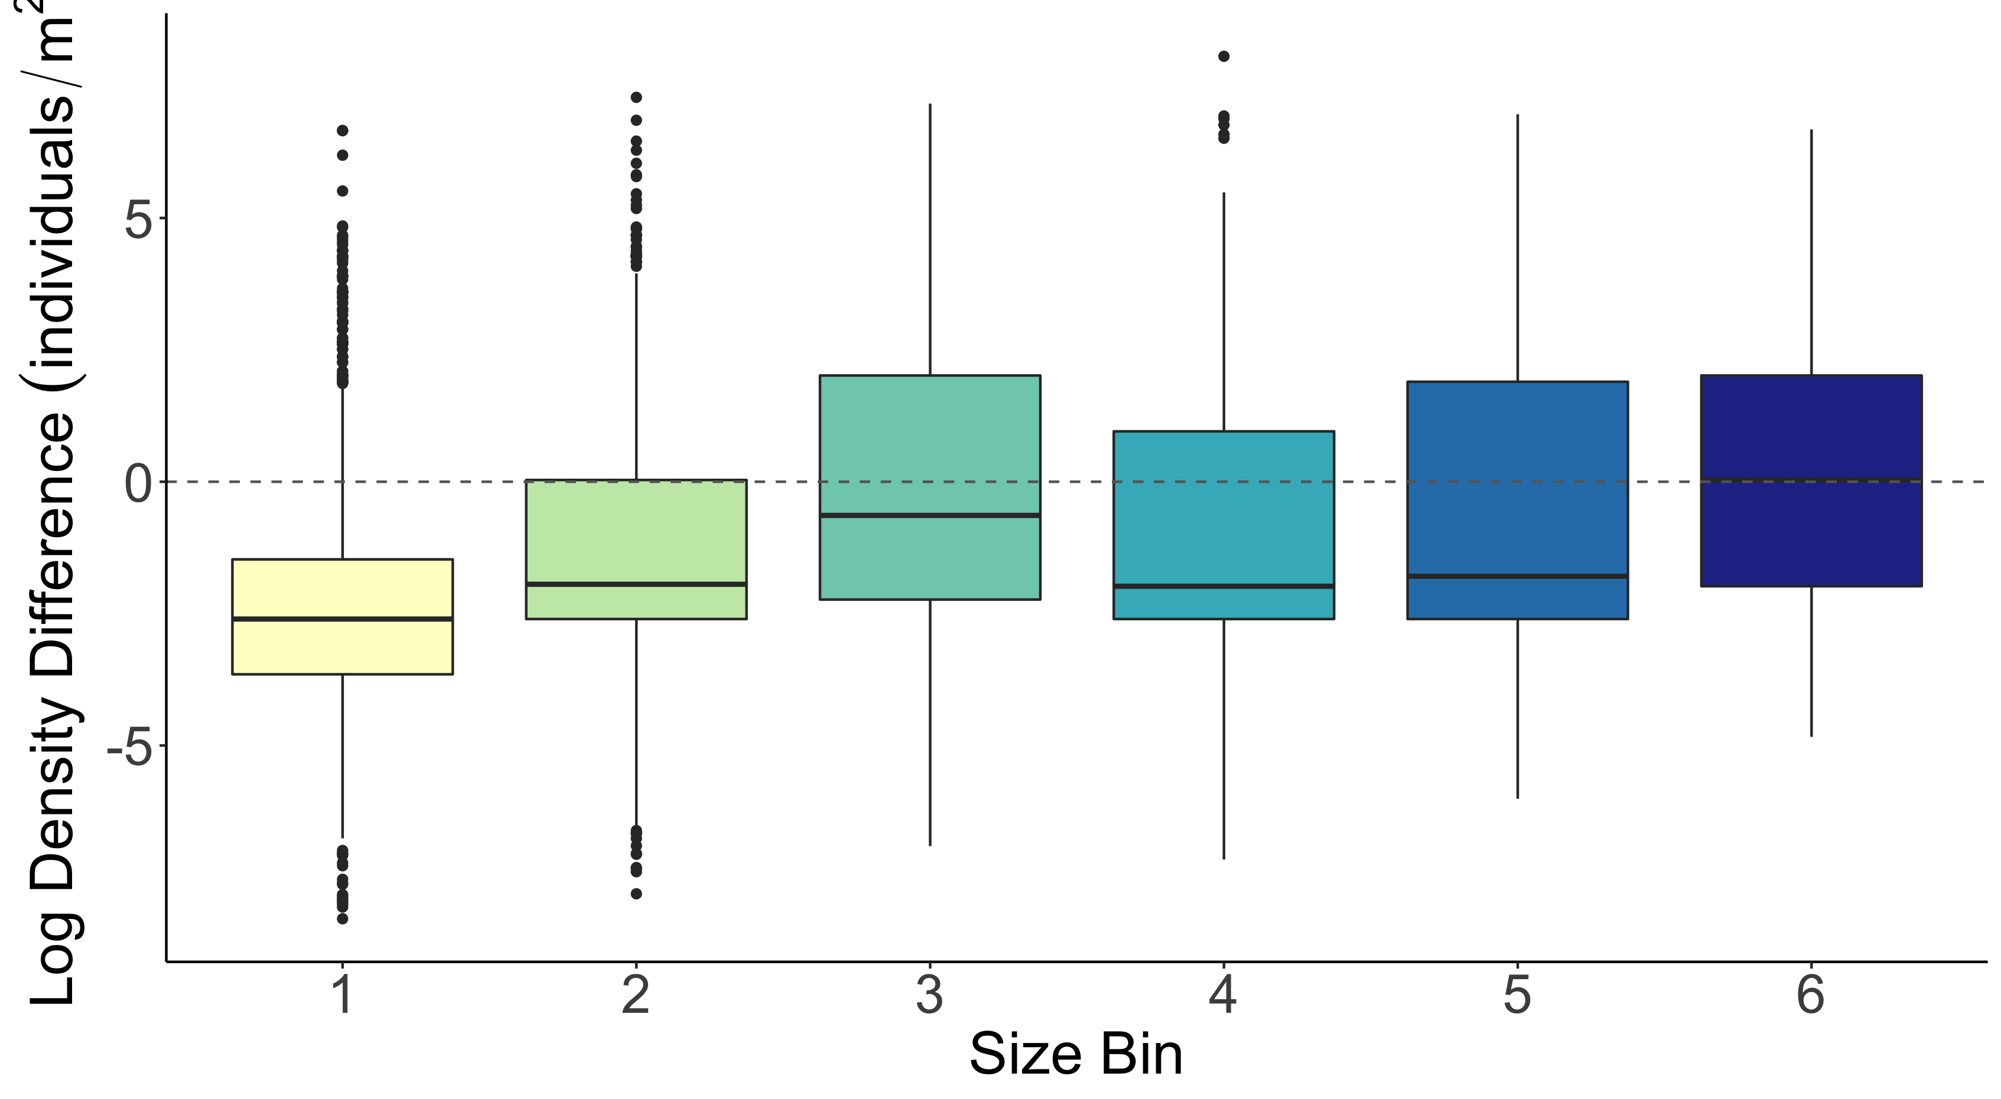
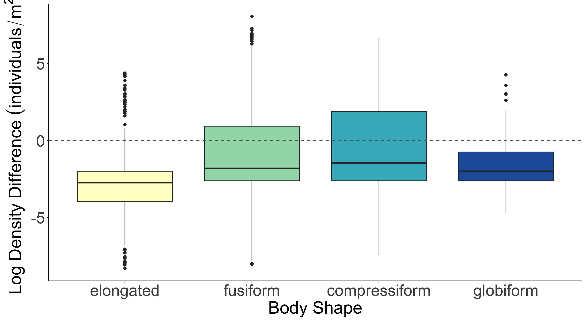
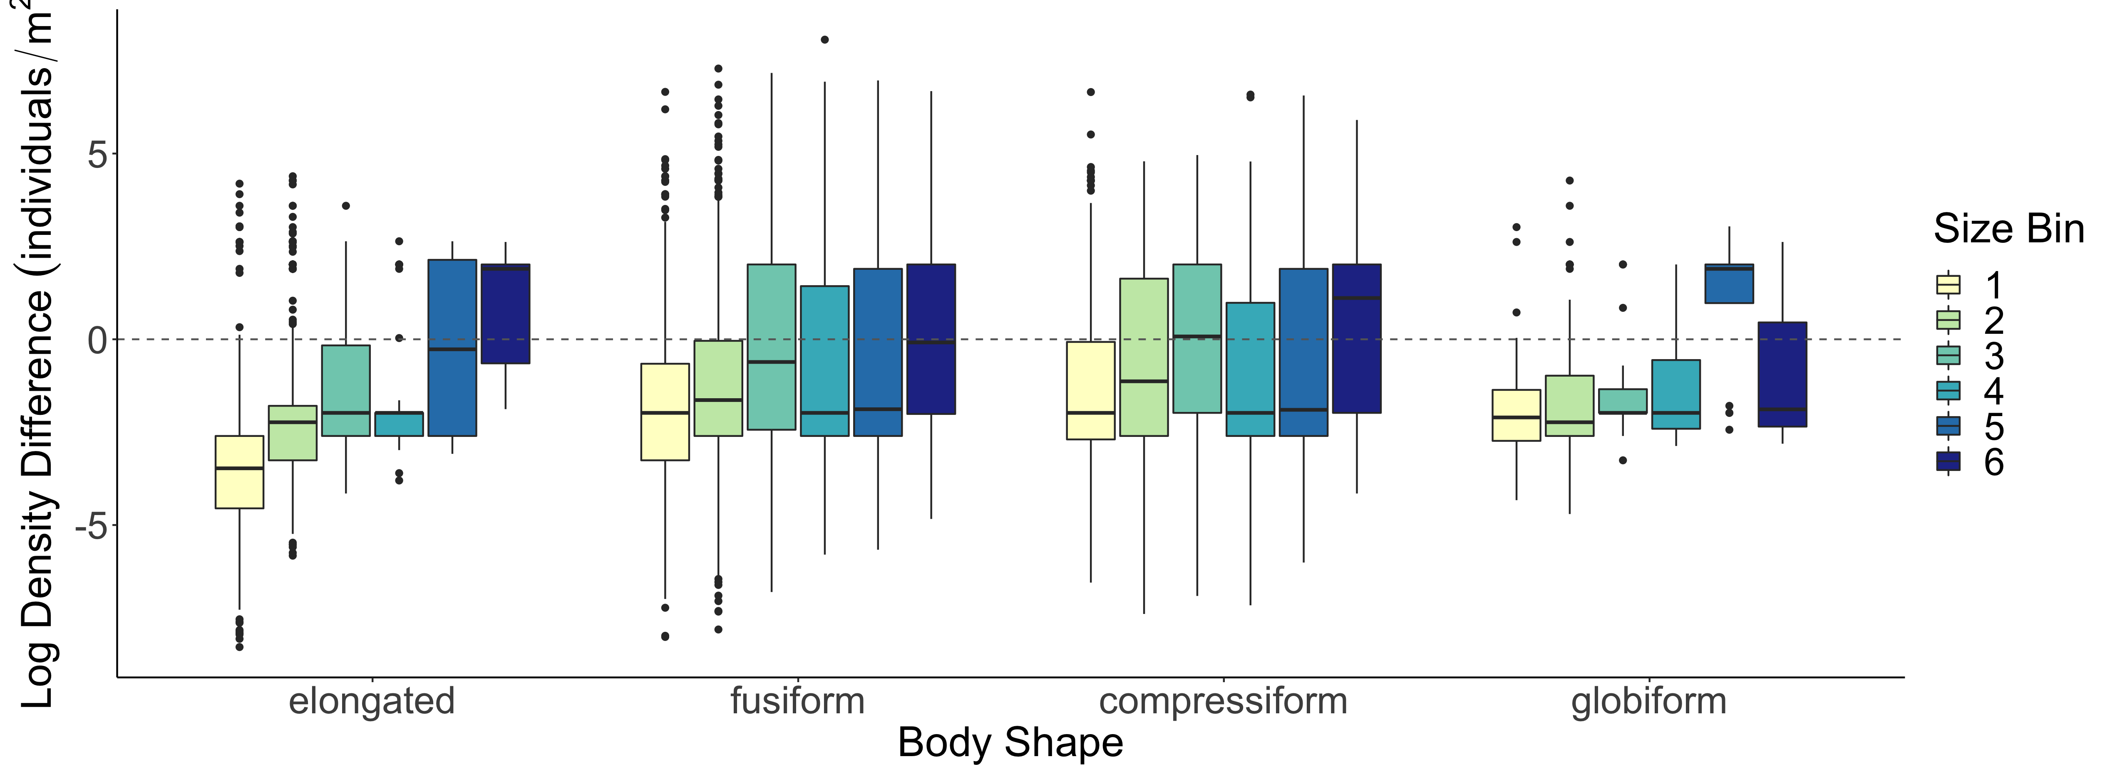
b
b
a
b
c
d
c
c
a
d
b
c
Log Density Difference (individuals/m²)
a
d

Slide 30
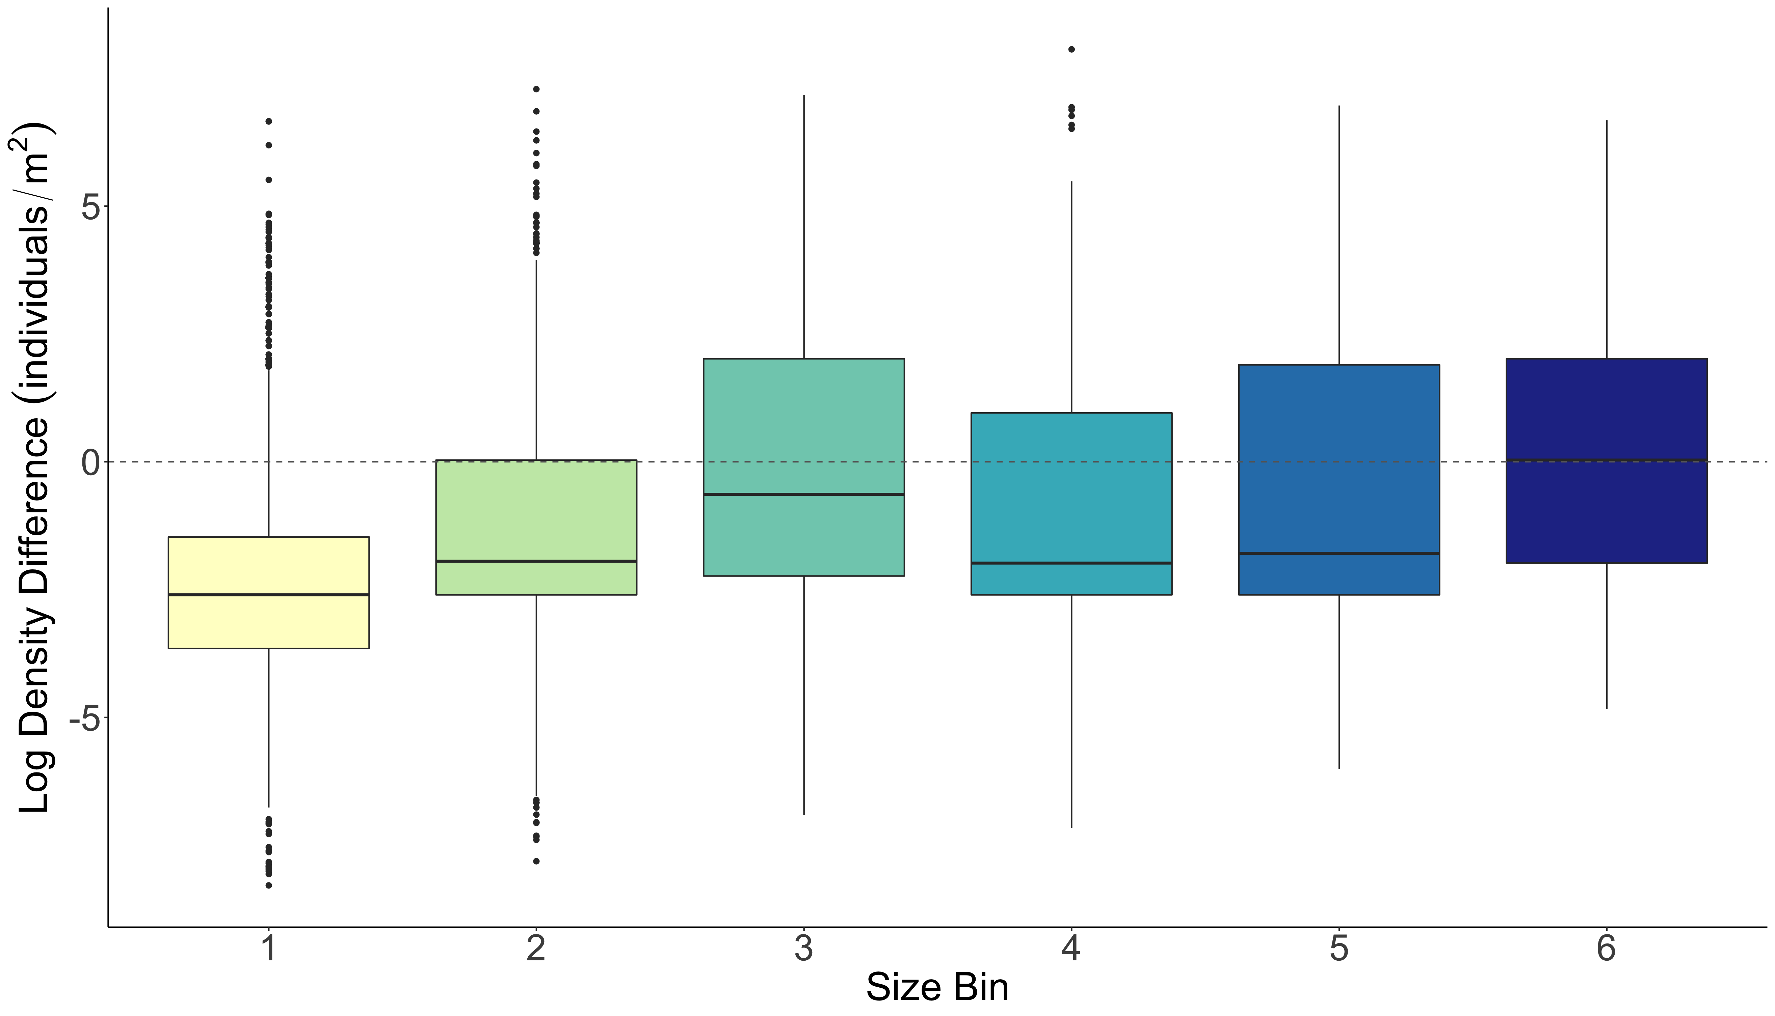
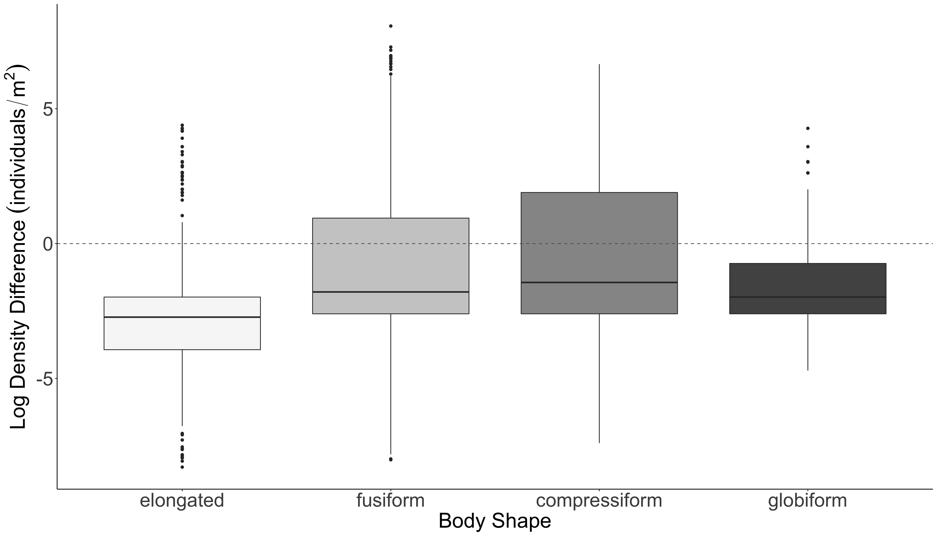
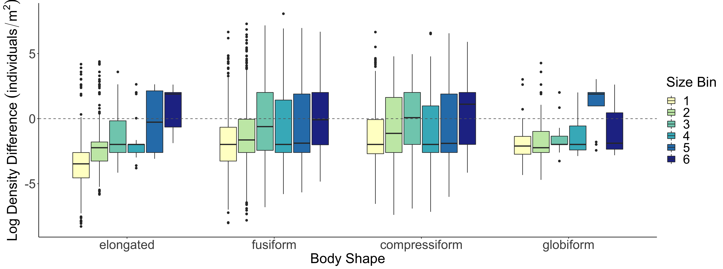
A.
b
c
b
B.
b
a
c
bc
b
a
ab
C.
Log Density Difference (individuals/m²)

Slide 31
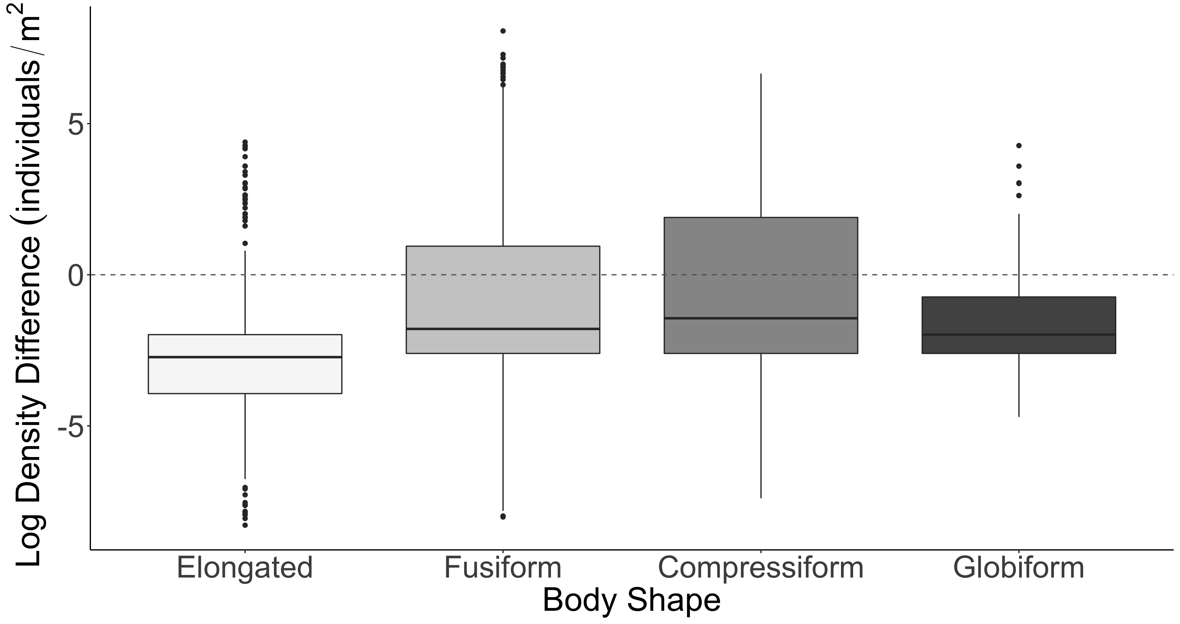
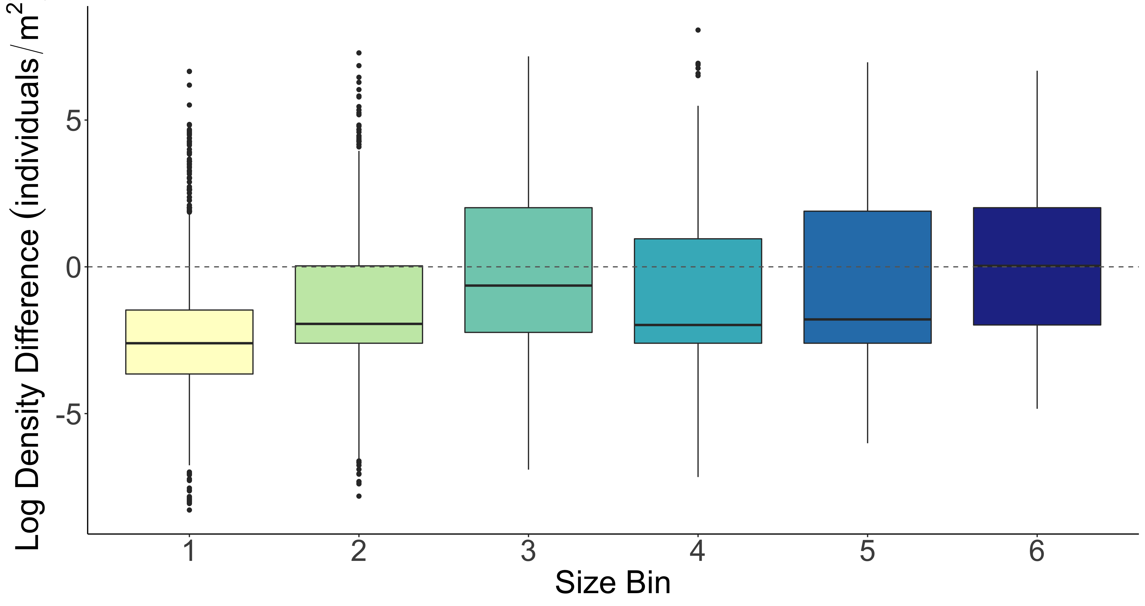
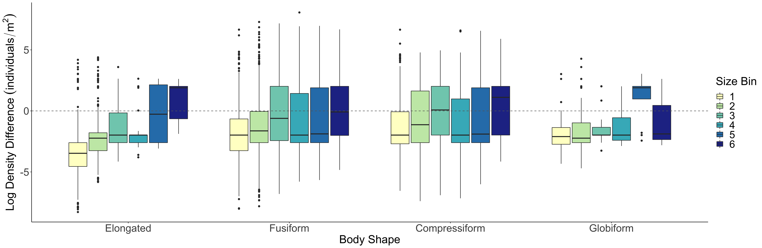
A.
b
B.
b
b
b
a
c
c
bc
a
ab
C.
Log Density Difference (individuals/m²)

Slide 32
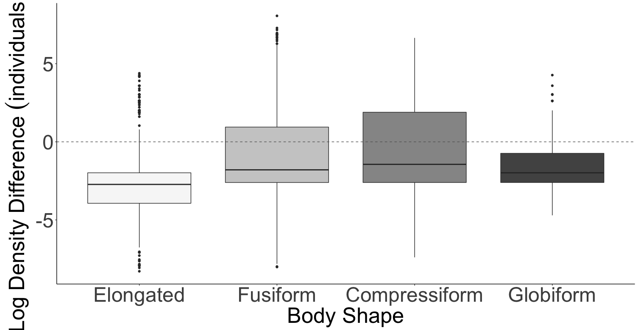
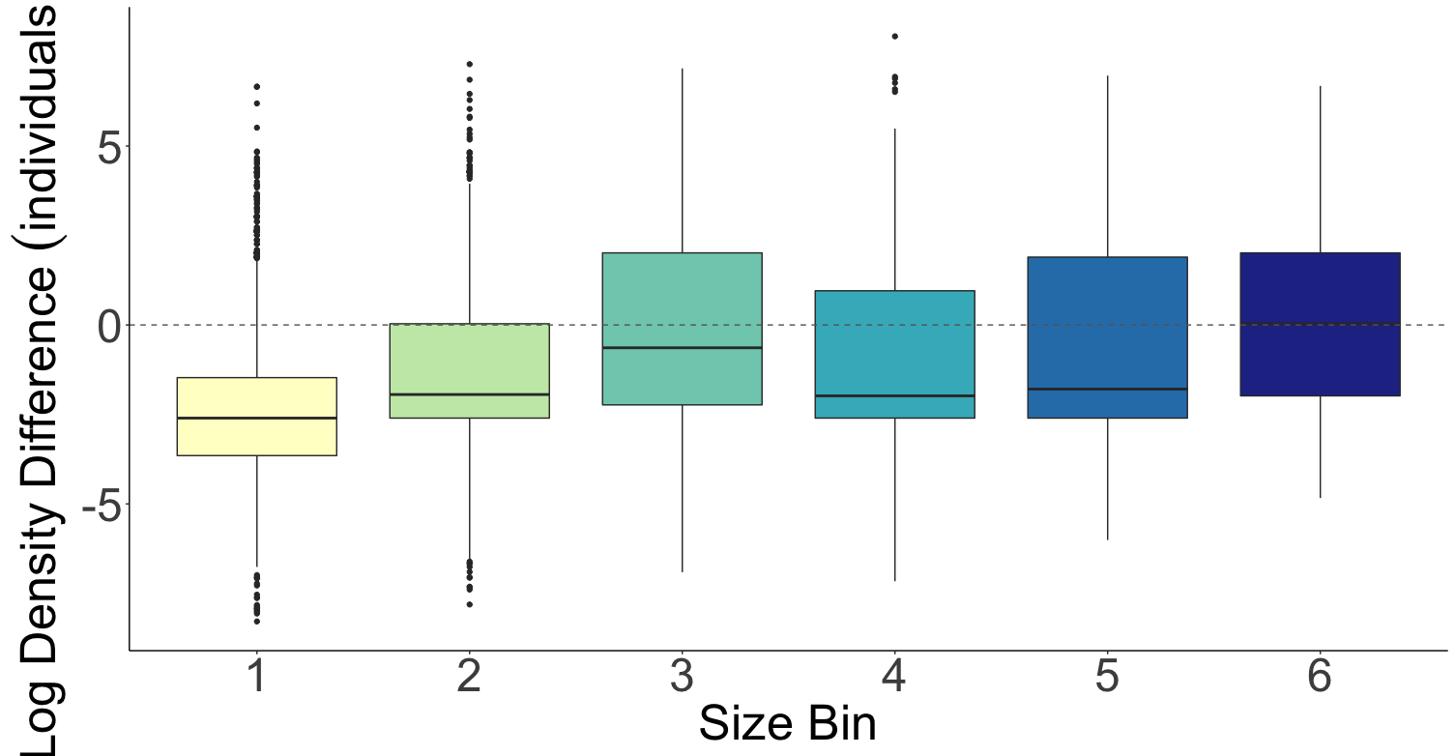
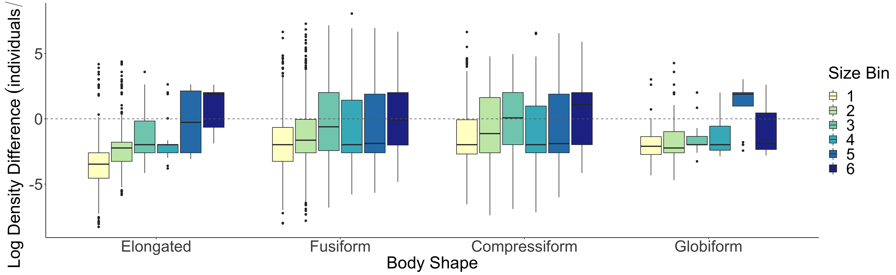
A.
b
B.
b
b
b
a
c
c
bc
a
ab
Log Density Difference (individuals/m²)
C.

Slide 33
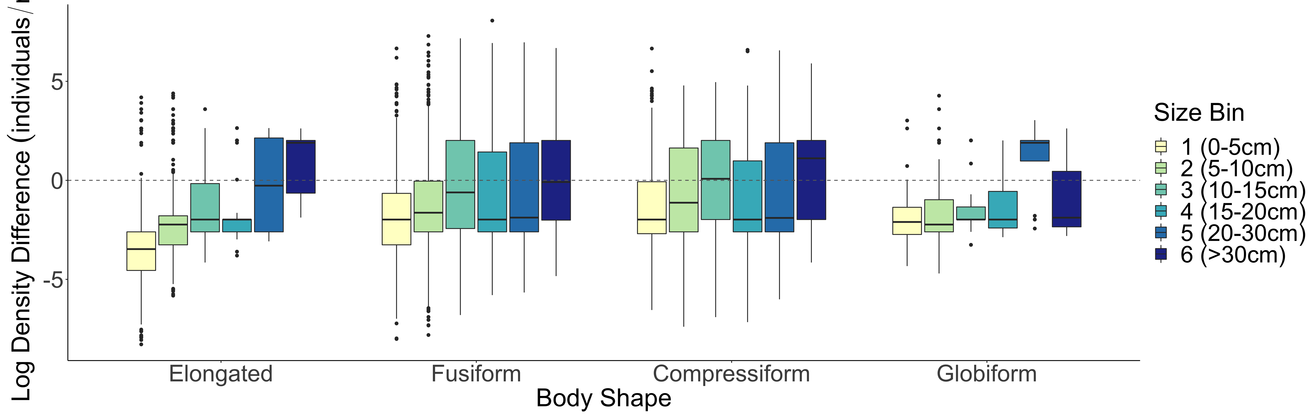
A.
b
B.
b
b
a
b
c
c
bc
a
ab
C.
Log Density Difference (individuals/m²)

Slide 34

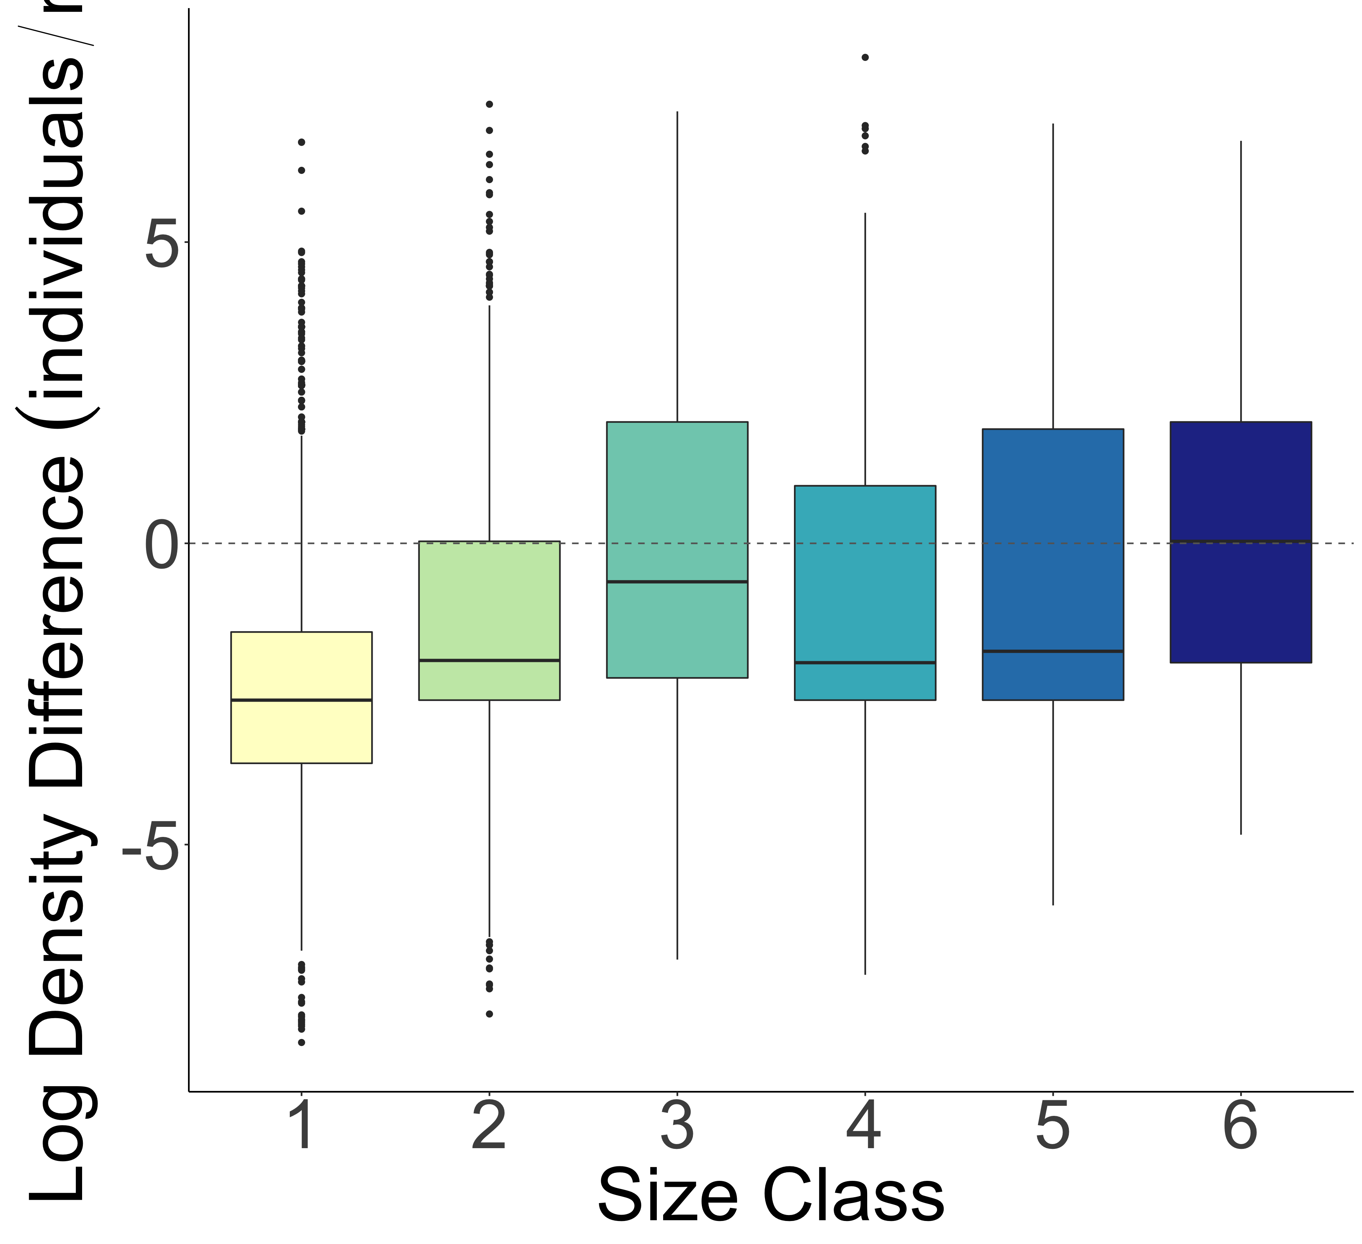
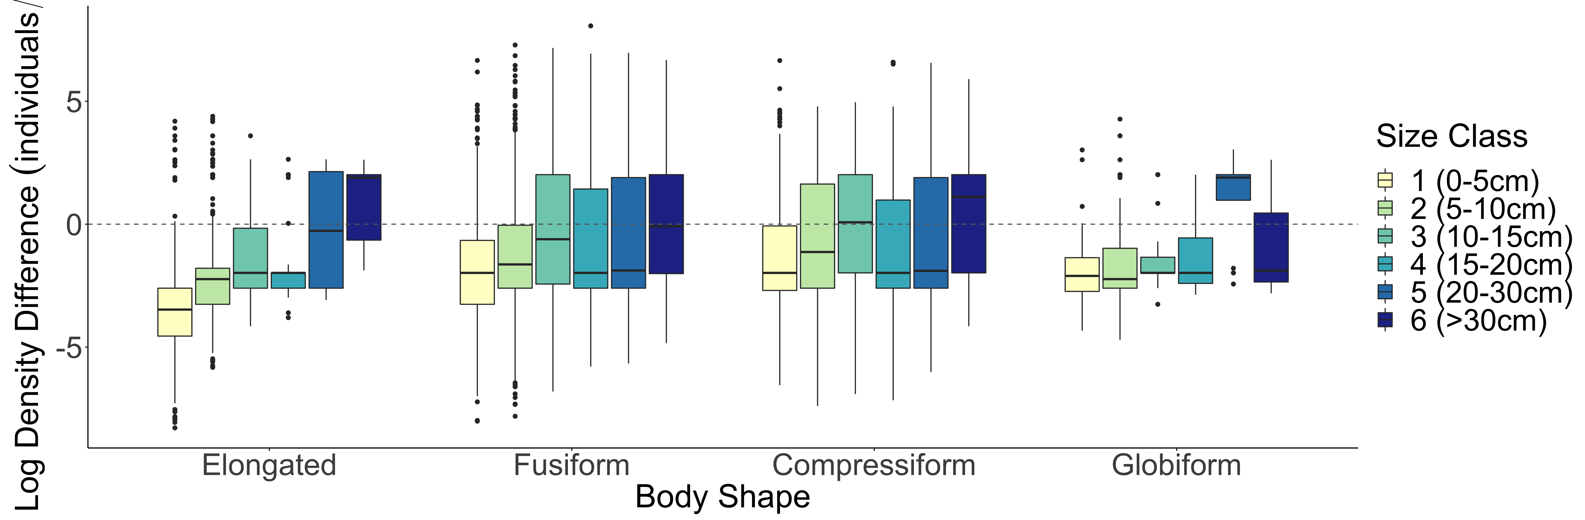
A.
b
B.
b
b
a
b
c
c
bc
a
ab
SVC
Density Greater
SVC
Density Greater
Belt Transect Density Greater
Belt Transect Density Greater
Log Density Difference (individuals/m²)
C.
SVC
Density Greater
Belt Transect Density Greater

Slide 35
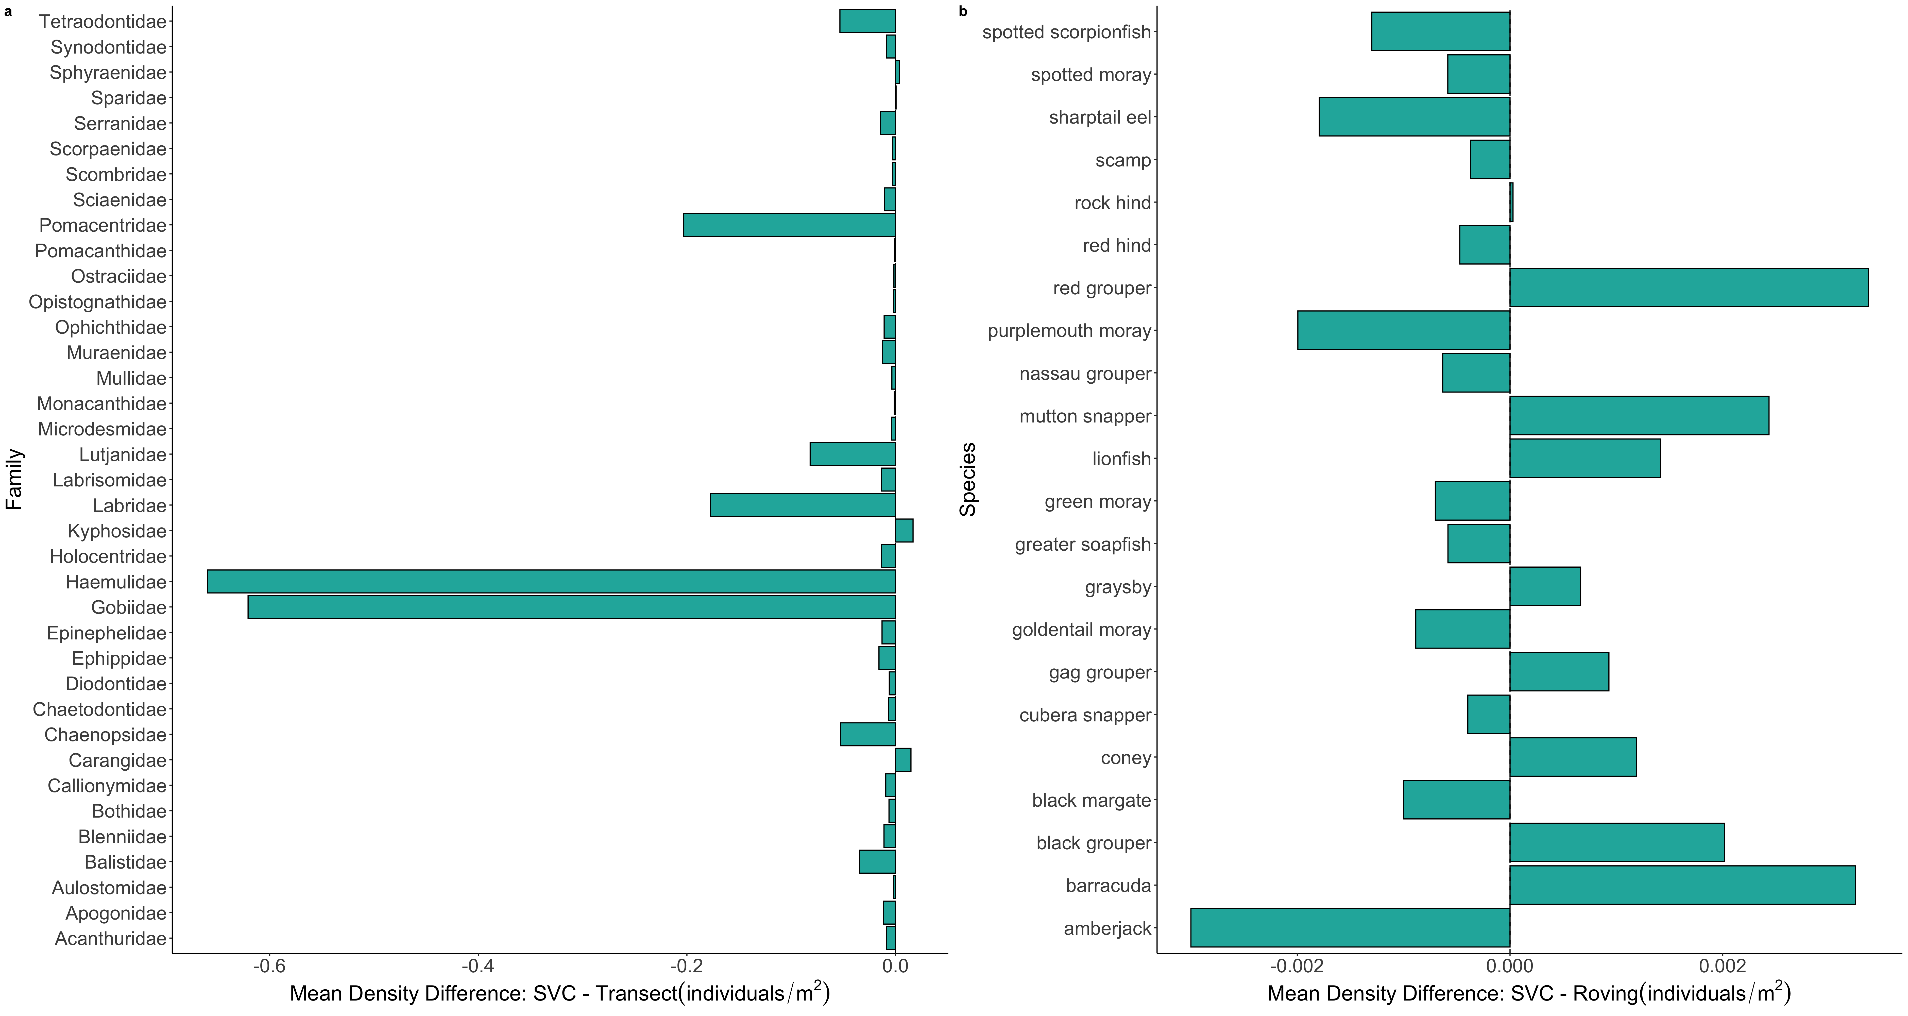
a
b

Slide 36
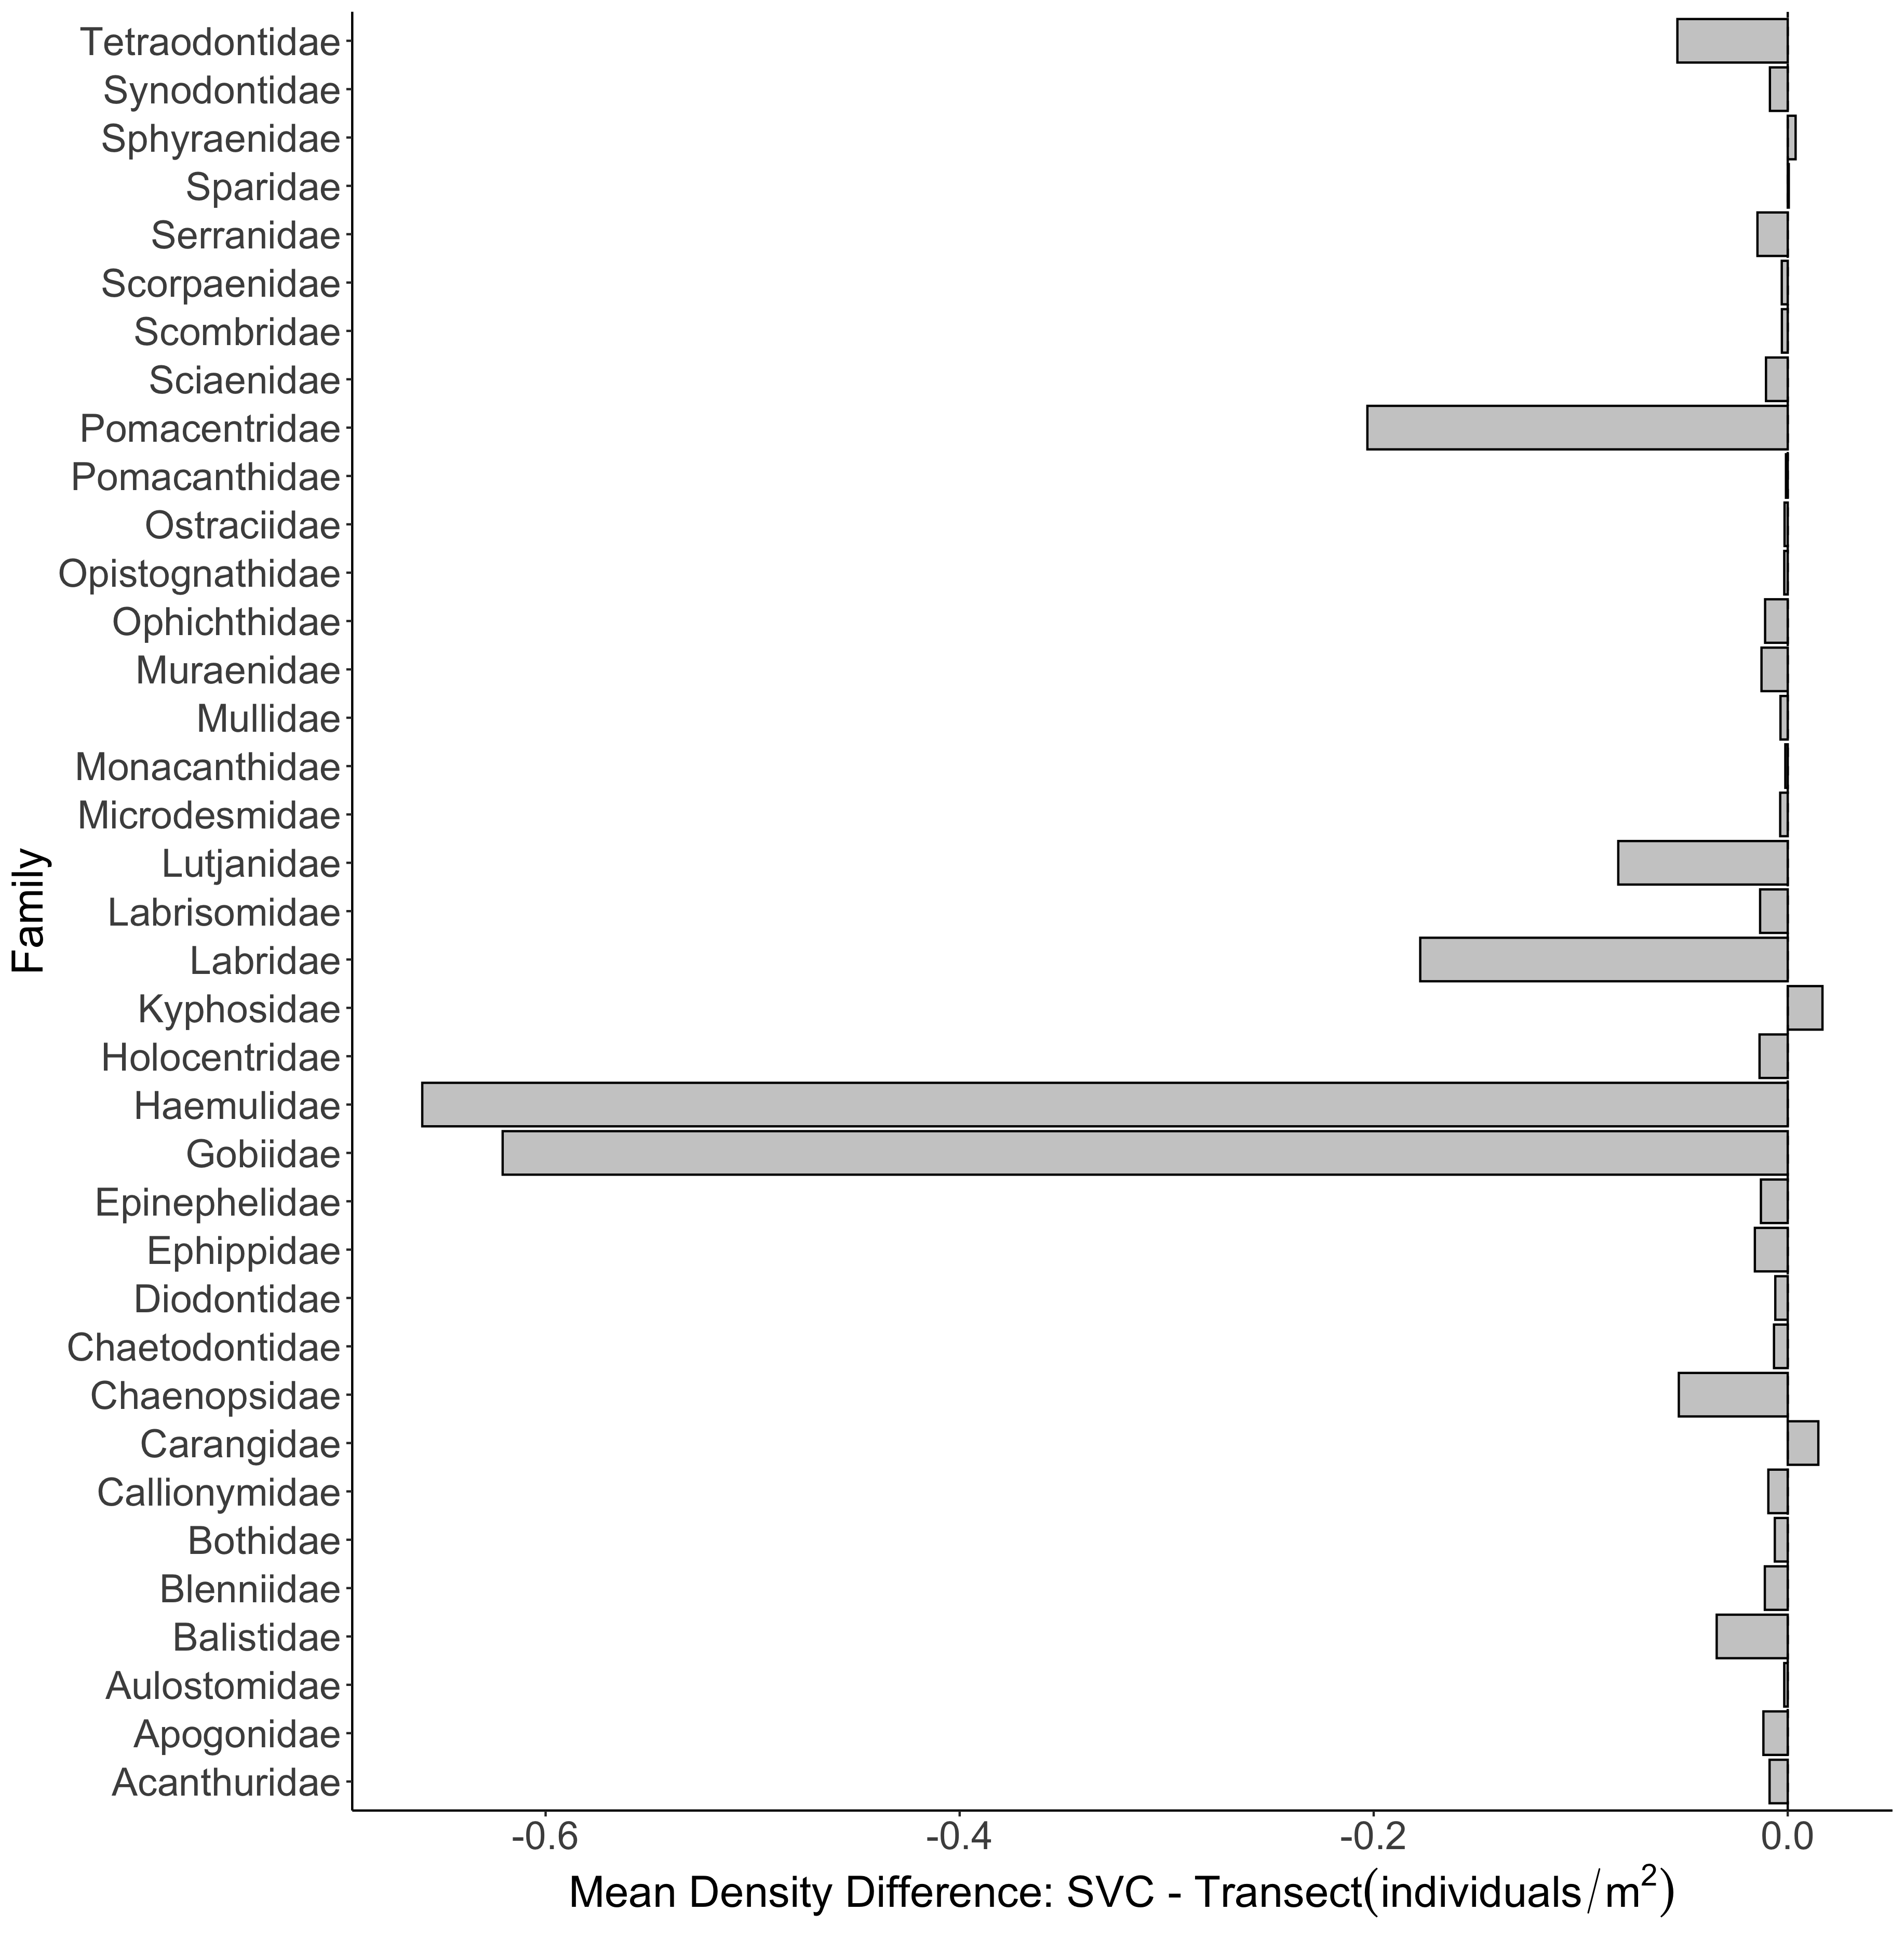
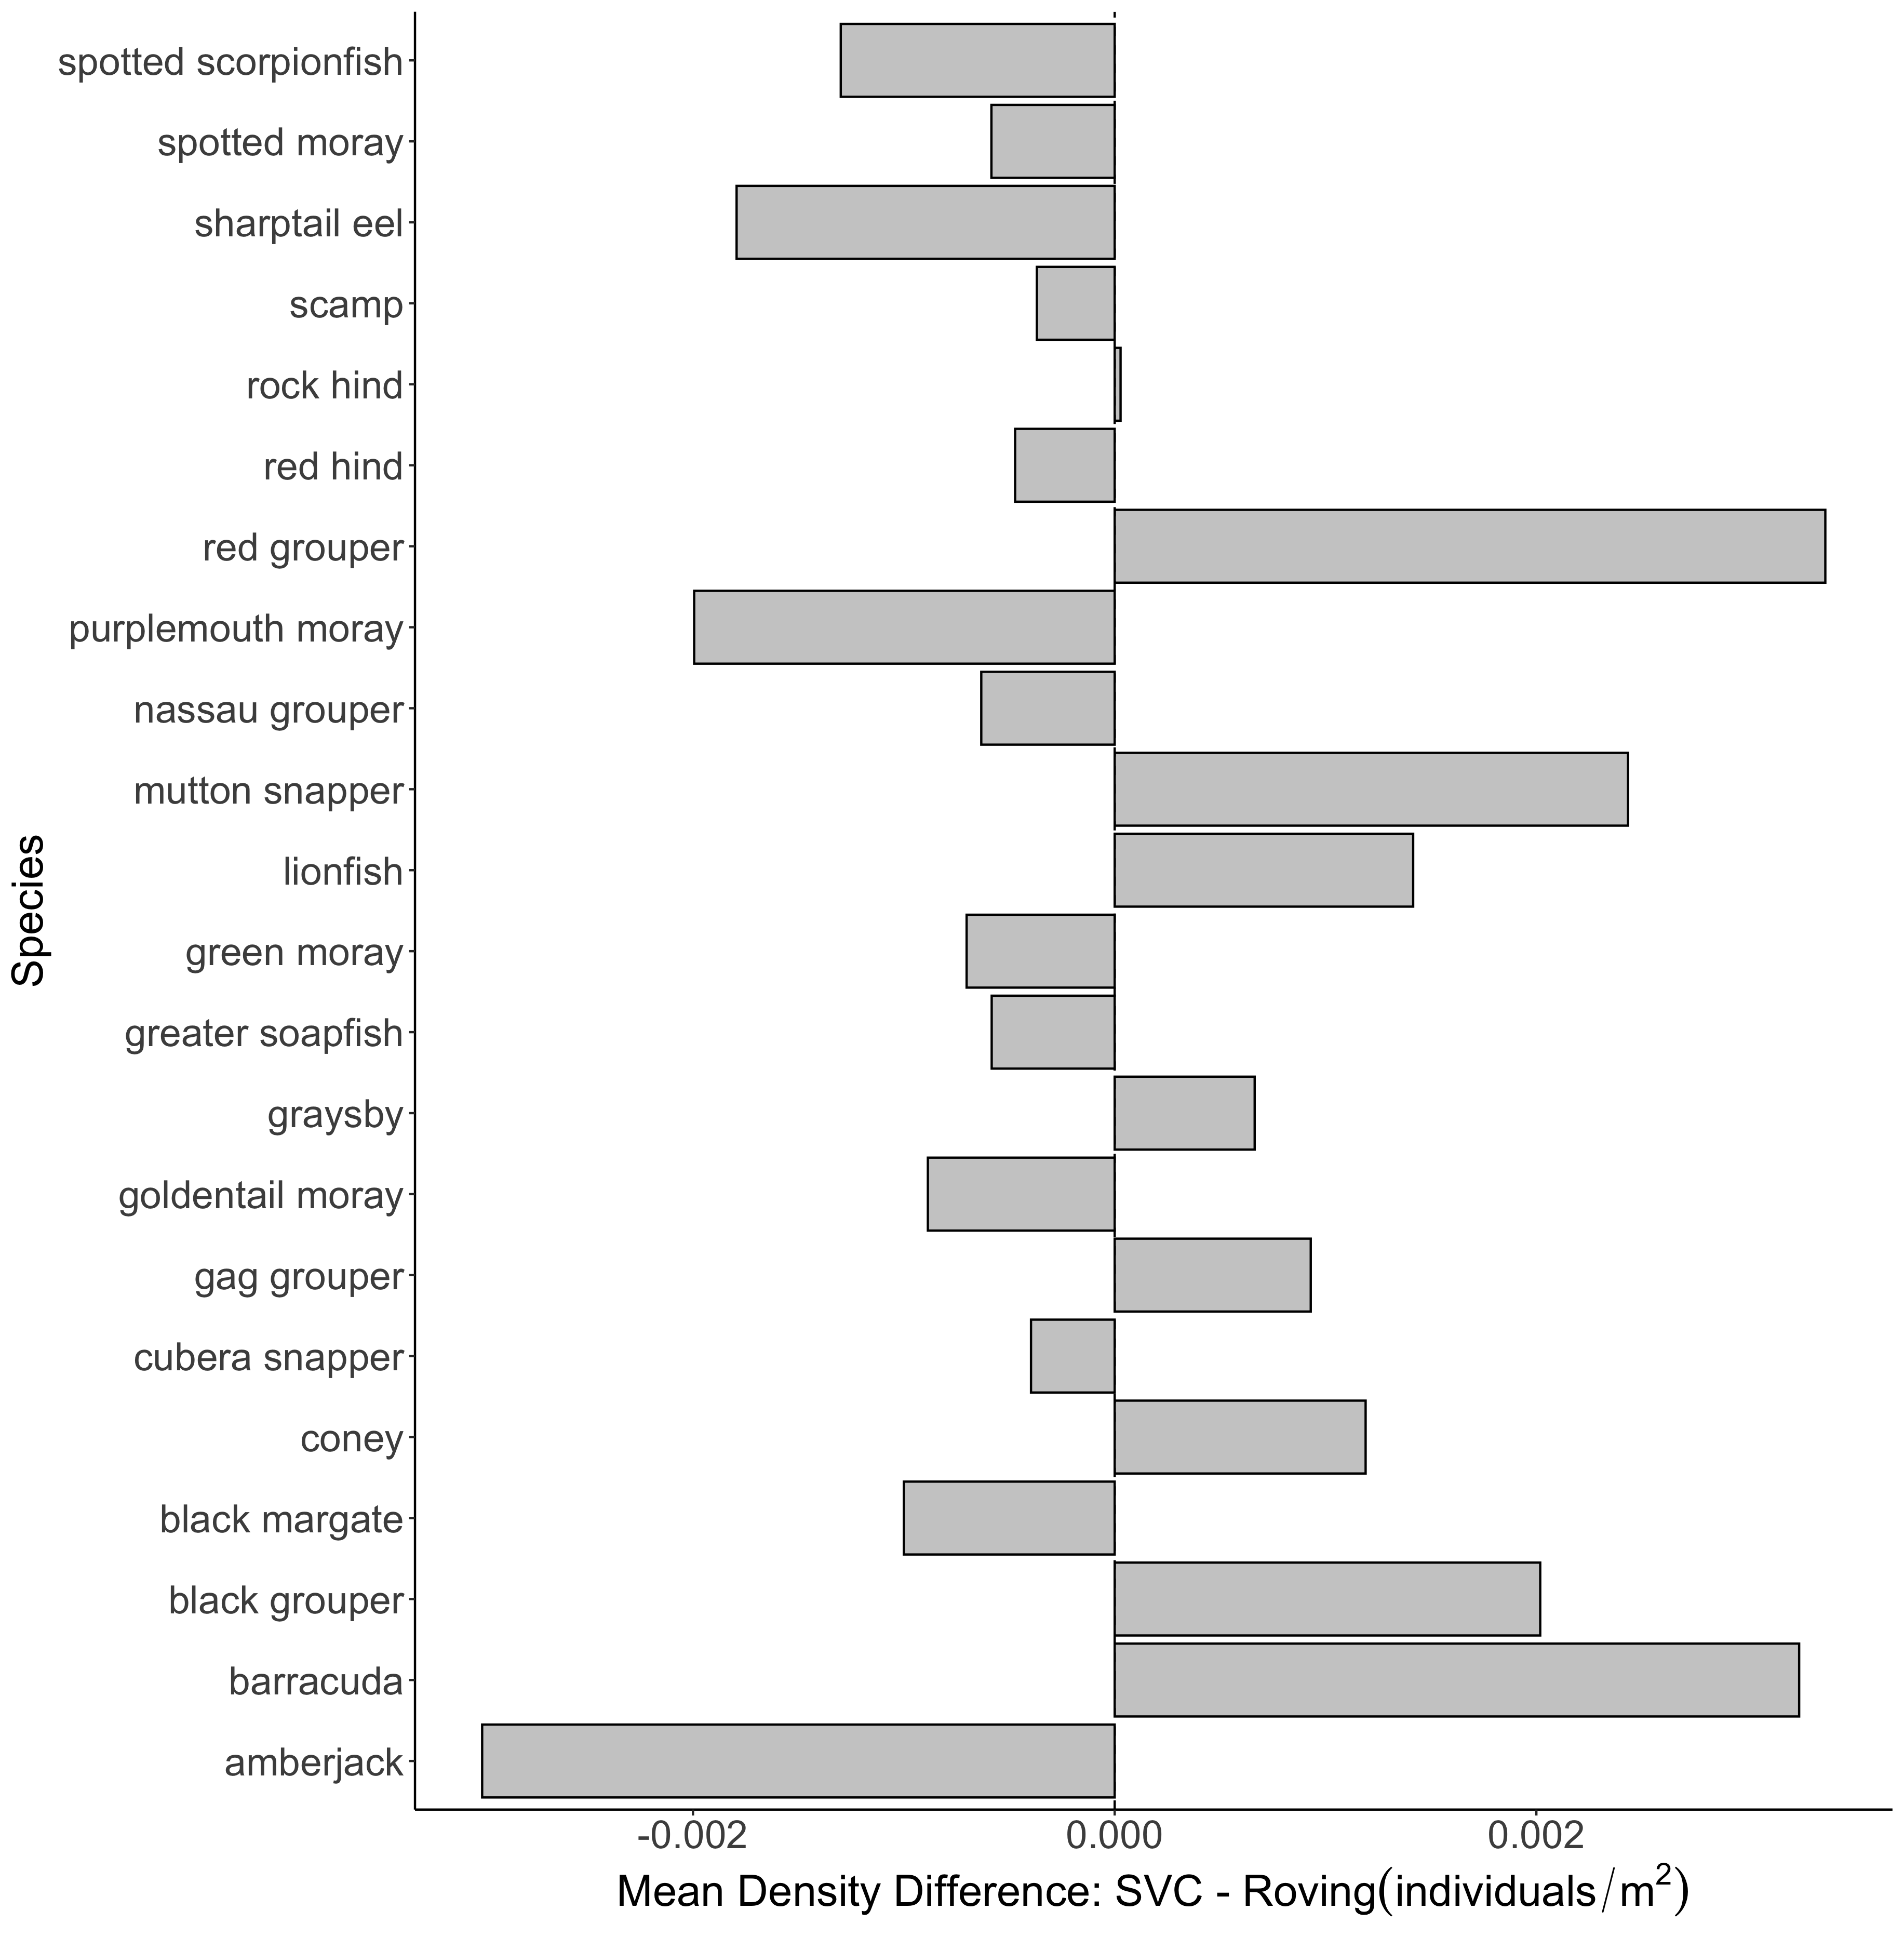
A.
B.

Slide 37
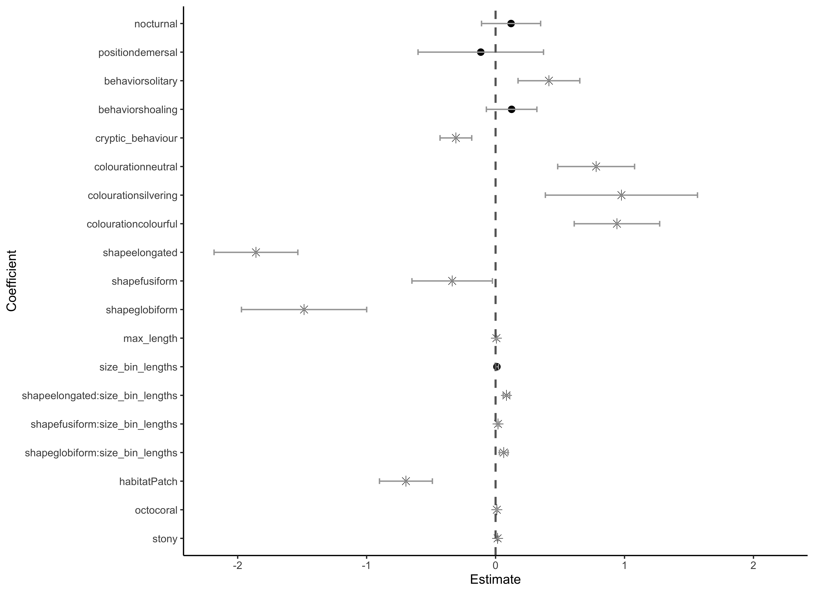
Aggregation
Coloration
Species Traits
Shape
Size*Shape
Habitat Traits

Slide 38
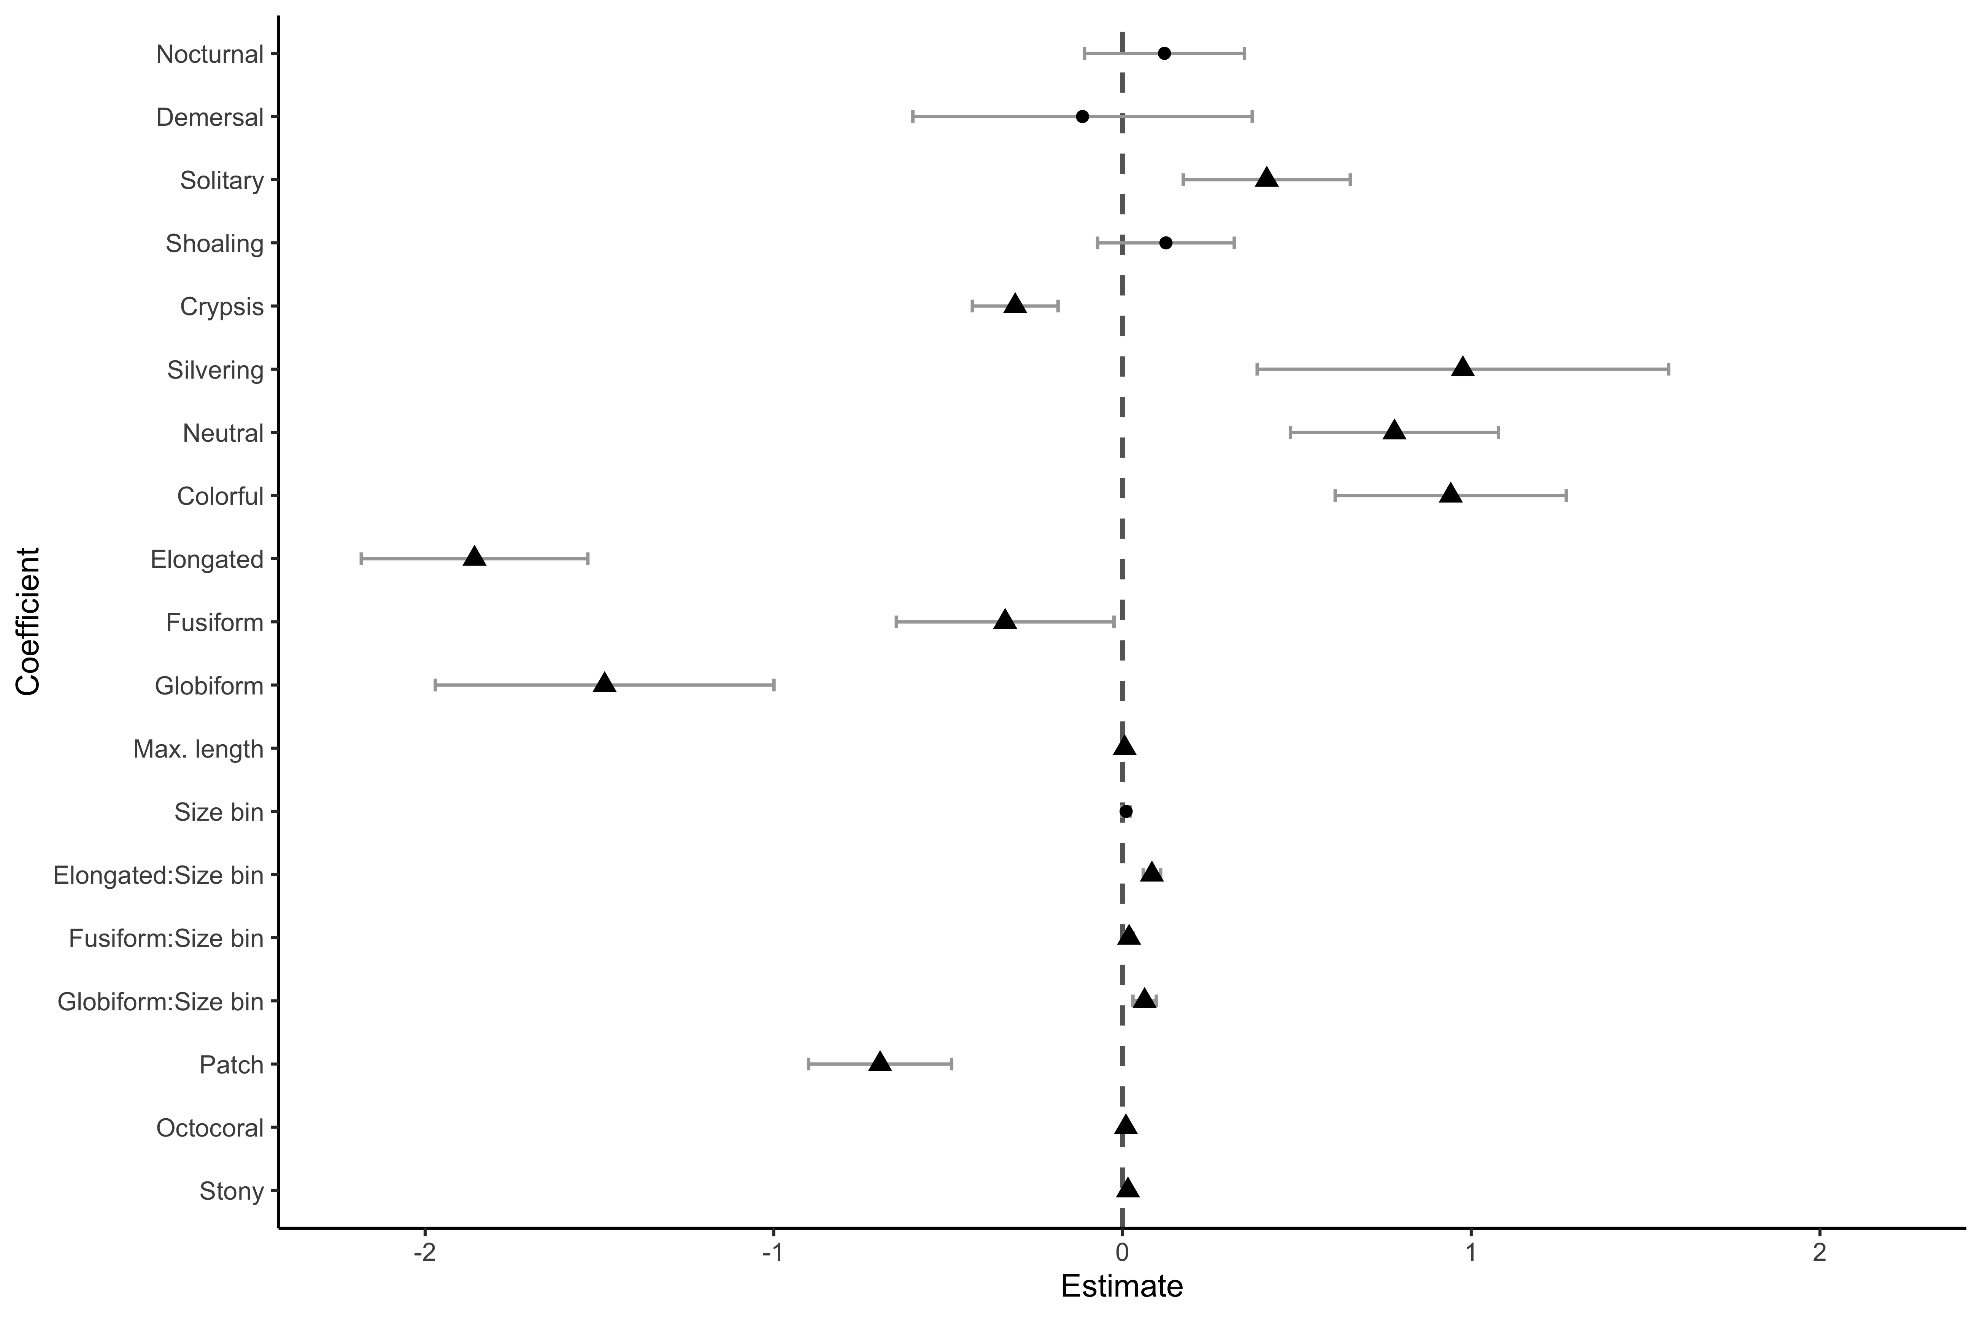

A.
Aggregation
Coloration
Species Traits
Shape
Shape*Size bin
Habitat Traits
B.
Coloration

Slide 39


A.
Aggregation
Coloration
Shape
Species Traits
Shape*Size bin
Habitat Traits
B.
Coloration

Slide 40

Belt Transect Density Greater
SVC
Density Greater
Roving
Density Greater
SVC
Density Greater

Slide 41


A.
Belt Transect Density Greater
SVC
Density Greater
Aggregation
schooling
Coloration
camouflage
Shape
compressiform
Species Traits
Shape*Size class
compressiform:size class
pelagic
continuous
Habitat Traits
B.
Roving
Density Greater
SVC
Density Greater
Coloration
camouflage

Slide 42
Belt Transect Density Greater
SVC
Density Greater
Aggregation
schooling
Coloration
camouflage
Shape
compressiform
Species Traits
Shape*Size class
compressiform:size class
pelagic
continuous
Habitat Traits

Slide 43




a
**
b
**
**
***
c
d
***
***

Slide 44




A.
C.
**
***
**
**
***
B.
D.
***
***
***

Slide 45


A.
Predictor
B.

Slide 46
Diagnostic plots

Slide 47


A.
B.

Slide 48


A.
B.

